Slide 1
Now available!
TM
powered by
John L. Scott’s NEW Connectivity Engine

Slide 2
What is JLS Engage?

Slide 3
Attended a Launch Week training?
Tell us what you think!
Please take a short, anonymous survey to help us improve.
We count on and truly appreciate your feedback!

Slide 4
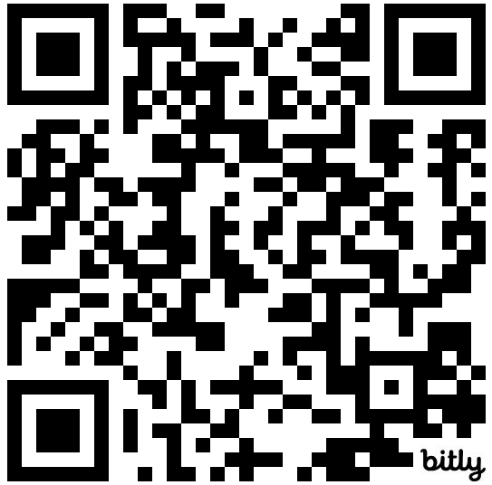
Wondering how to get started?
JLS Engage
Getting Started Guide
Computer settings, first-time login
tips, etc.

Slide 5
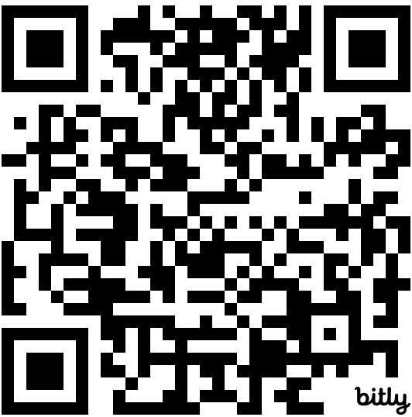
Wondering how to get started?
JLS Engage
Resource Library
Short tutorial videos on most Engage features.

Slide 6
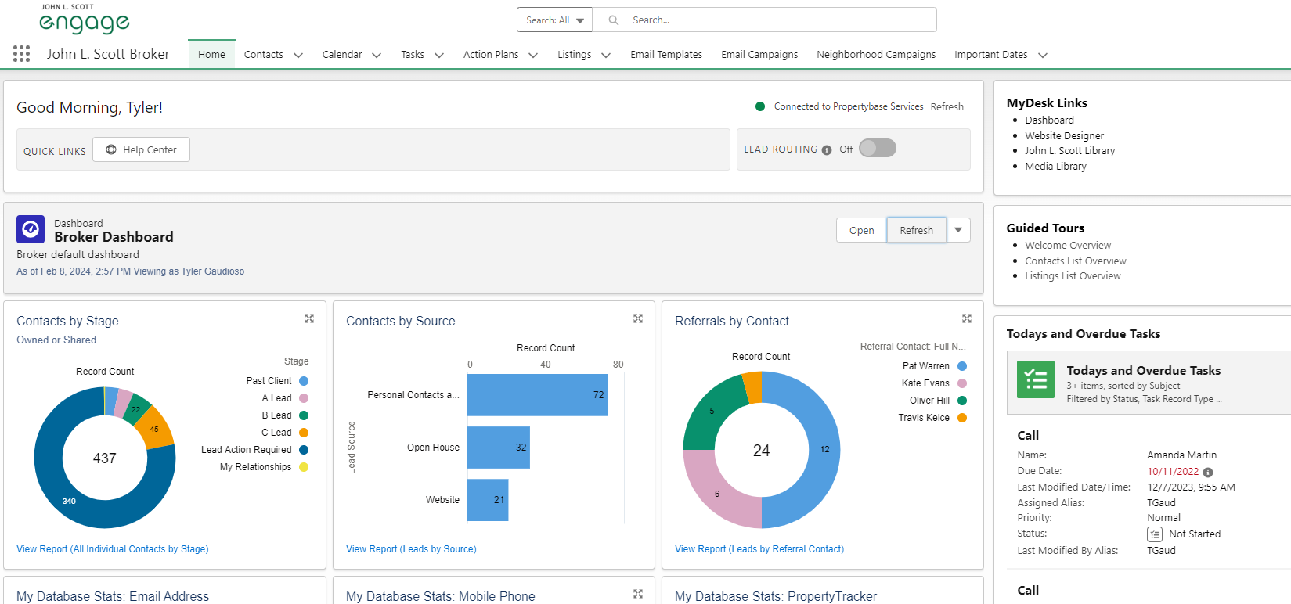
Wondering how to get started?
JLS Engage Guided Tours:
Real-time training tips on how to use JLS Engage

Slide 7
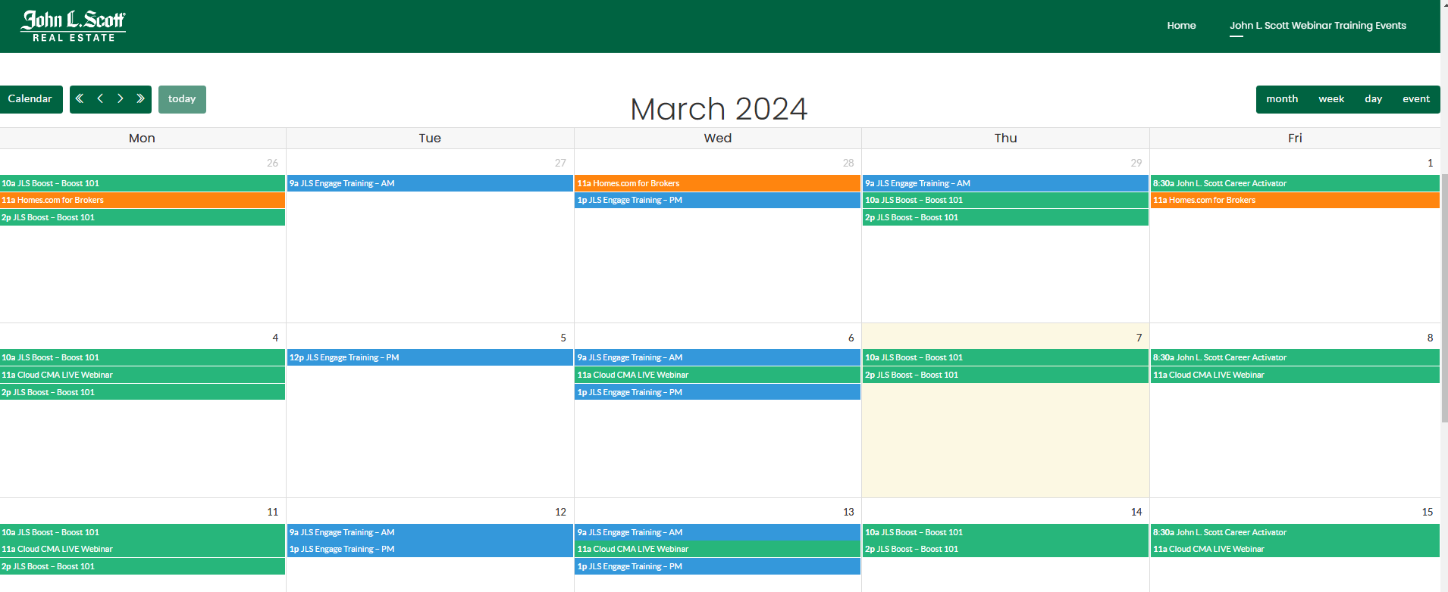
Couldn’t attend a Launch Week
training session?
To see a calendar of upcoming live Zoom sessions, please visit:
https://jlstraining.com/webinartraining/
JLS Engage sessions are in blue:

Slide 8
Find JLS Engage in MyDesk…

Slide 9
And download the Mobile App!
Google Play Store (Android)
Apple App Store (iPhone/iPad)

Slide 10
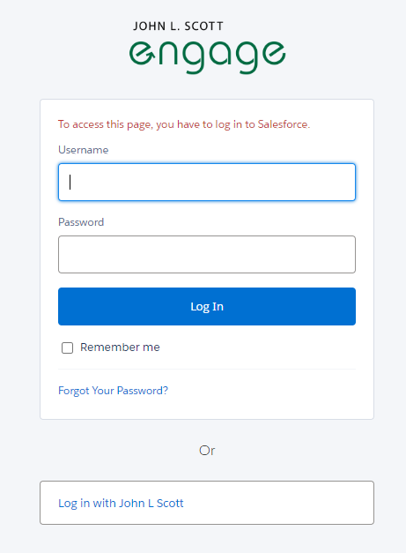
Be sure to
“Log In with John L. Scott”…

Slide 11
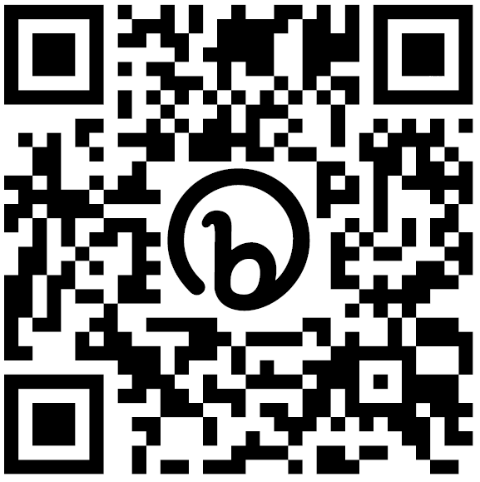
And don’t hesitate to reach out for support

Slide 12
Now available!
TM
powered by
John L. Scott’s NEW Connectivity Engine

