Slide 1
HOME SELLER GUIDE
Marketing and Pricing Strategy

Slide 2
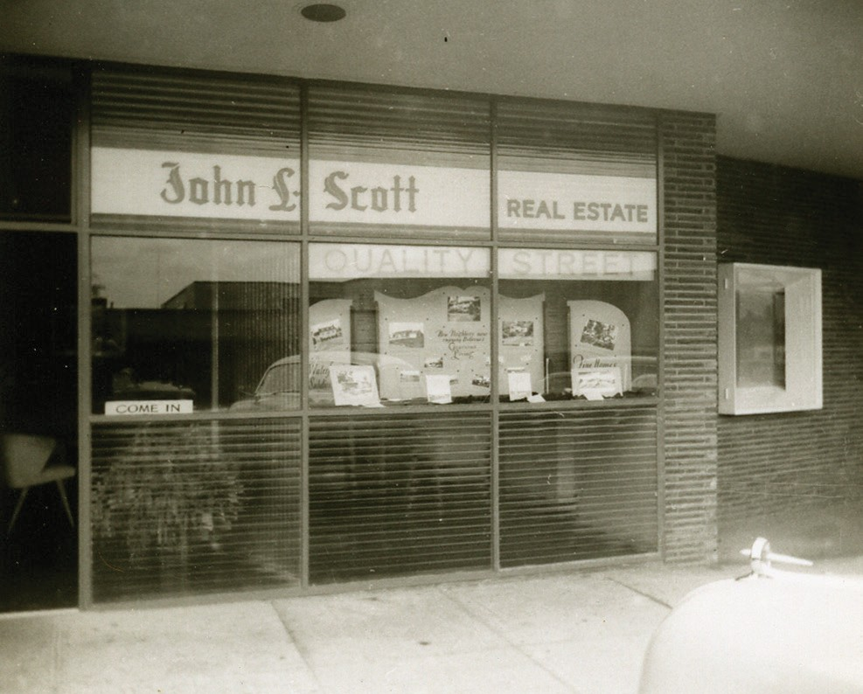
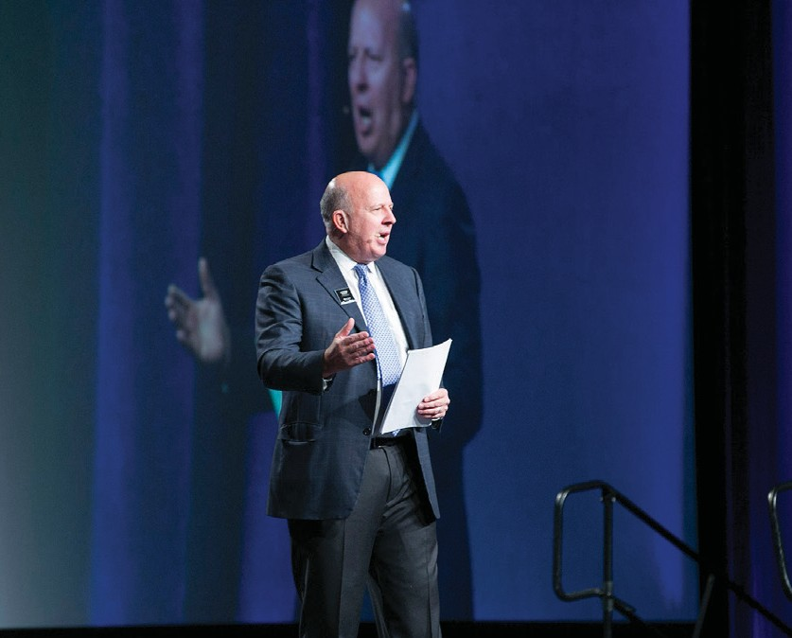
Our History is Your Advantage
John L. Scott Real Estate was founded in downtown Seattle in 1931 and continues to be locally owned and operated. The company has grown throughout Washington, Oregon, Idaho, and Northern California.
Led by the grandson of founder John L. Scott, Chairman and CEO J. Lennox Scott is nationally recognized as one of the top 30 most influential leaders in the industry. He leads with the vision that "our business is real estate, but our core value is Living Life as a Contribution®.”
Deeply rooted in the Northwest with strong local, national and global presence, John L. Scott Real Estate is consistently recognized as one of the most productive brands in the nation.
Over 90 years
of innovation and success

Slide 3
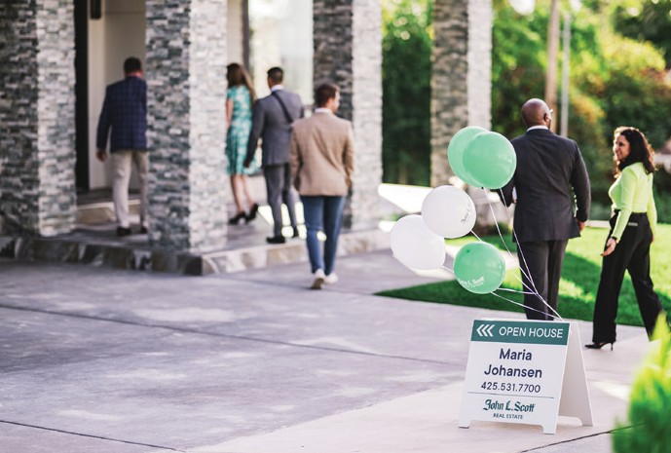
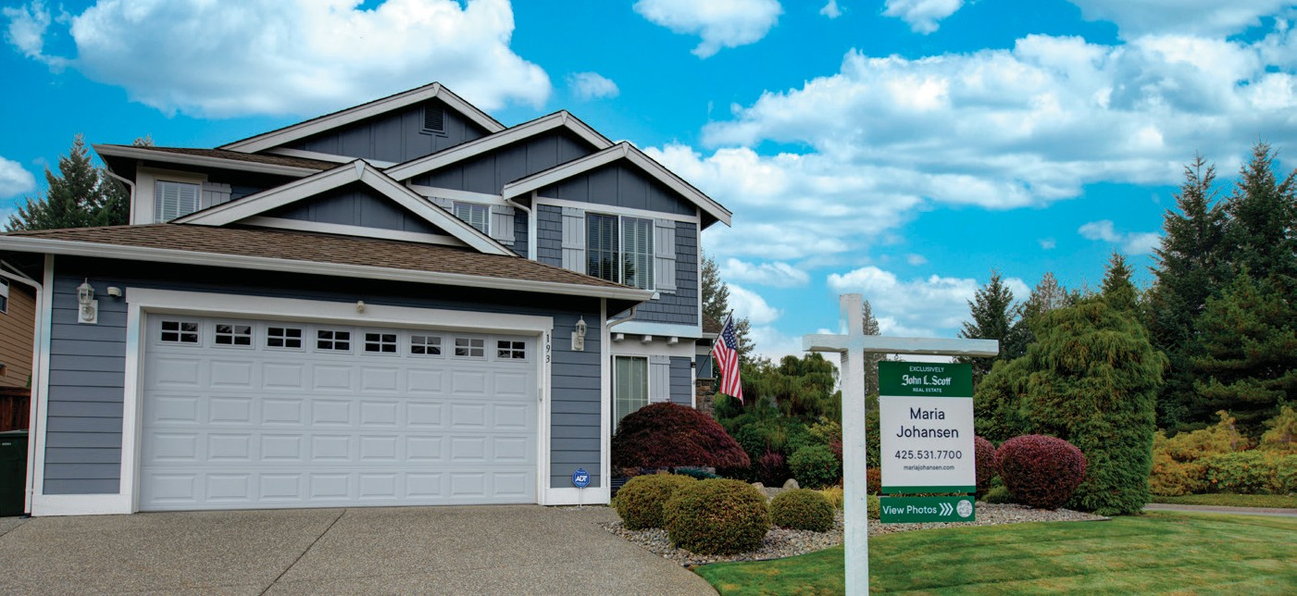
Your Trusted Advisor
Selling your home can be complicated and overwhelming. We provide you with peace of mind through our extensive knowledge of the market, showing your home in the best light, transactional excellence, negotiation expertise, and being your advocate throughout the entire process.
Your personal representative and advocate throughout
the home
selling process
SOLD

Slide 4
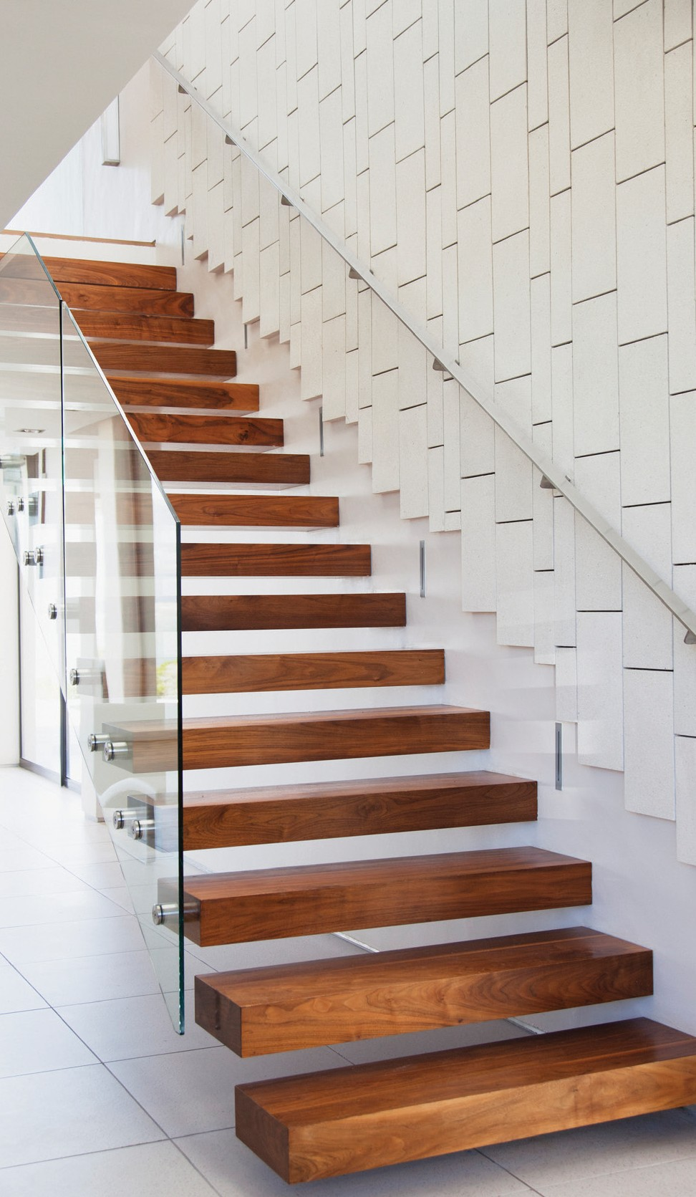
Steps to get Your Home Sold
1
2
Identify Your Priorities
Market Ready, Day One™
Simplifying, Staging, and Cleaning
Photography
Comprehensive Marketing Approach
Digital Marketing Strategy
Local and Global Reach
Seller Listing Launch®
Pricing Your Home
Intelligent Pricing
Sales Activity Intensity™
Understanding the Transaction Process
3
4
5
6
7
A Successful Negotiation
From Start to Close: The Home Seller Journey

Slide 5
Identify Your Priorities
What’s important to you?

Slide 6
Market Ready, Day One™
Showcasing your home in the best light to get the best price
“
You never get a second chance
to make a first impression
- Will Rogers
Photo by: Clarity Northwest Photography

Slide 7
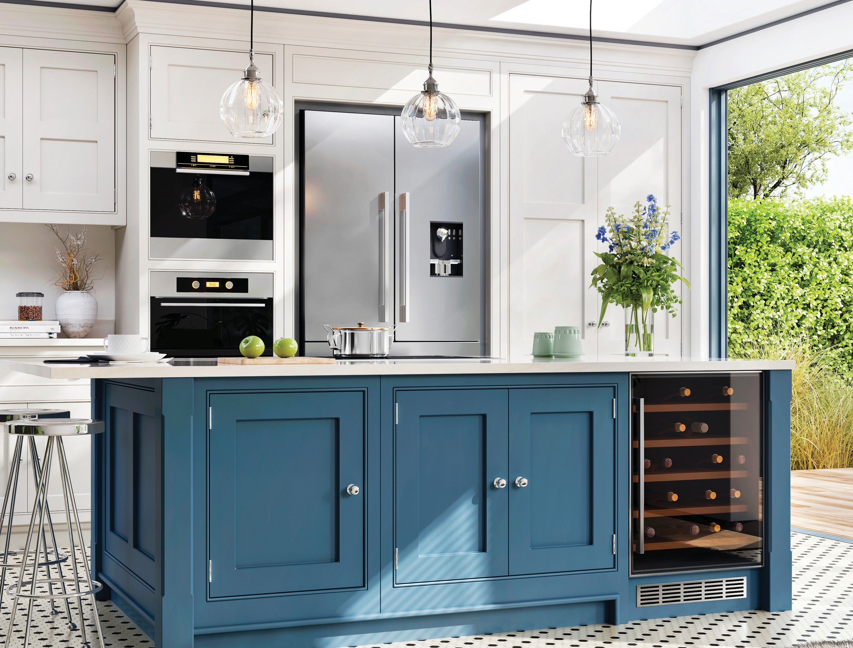
The Little Details Matter
Making sure every aspect of your home is ready the moment it hits the market
Landscaping
Roof
Paint
Doors
Windows
HVAC System
Home Appliances
Lighting
Flooring
Kitchen
Bathroom

Slide 8
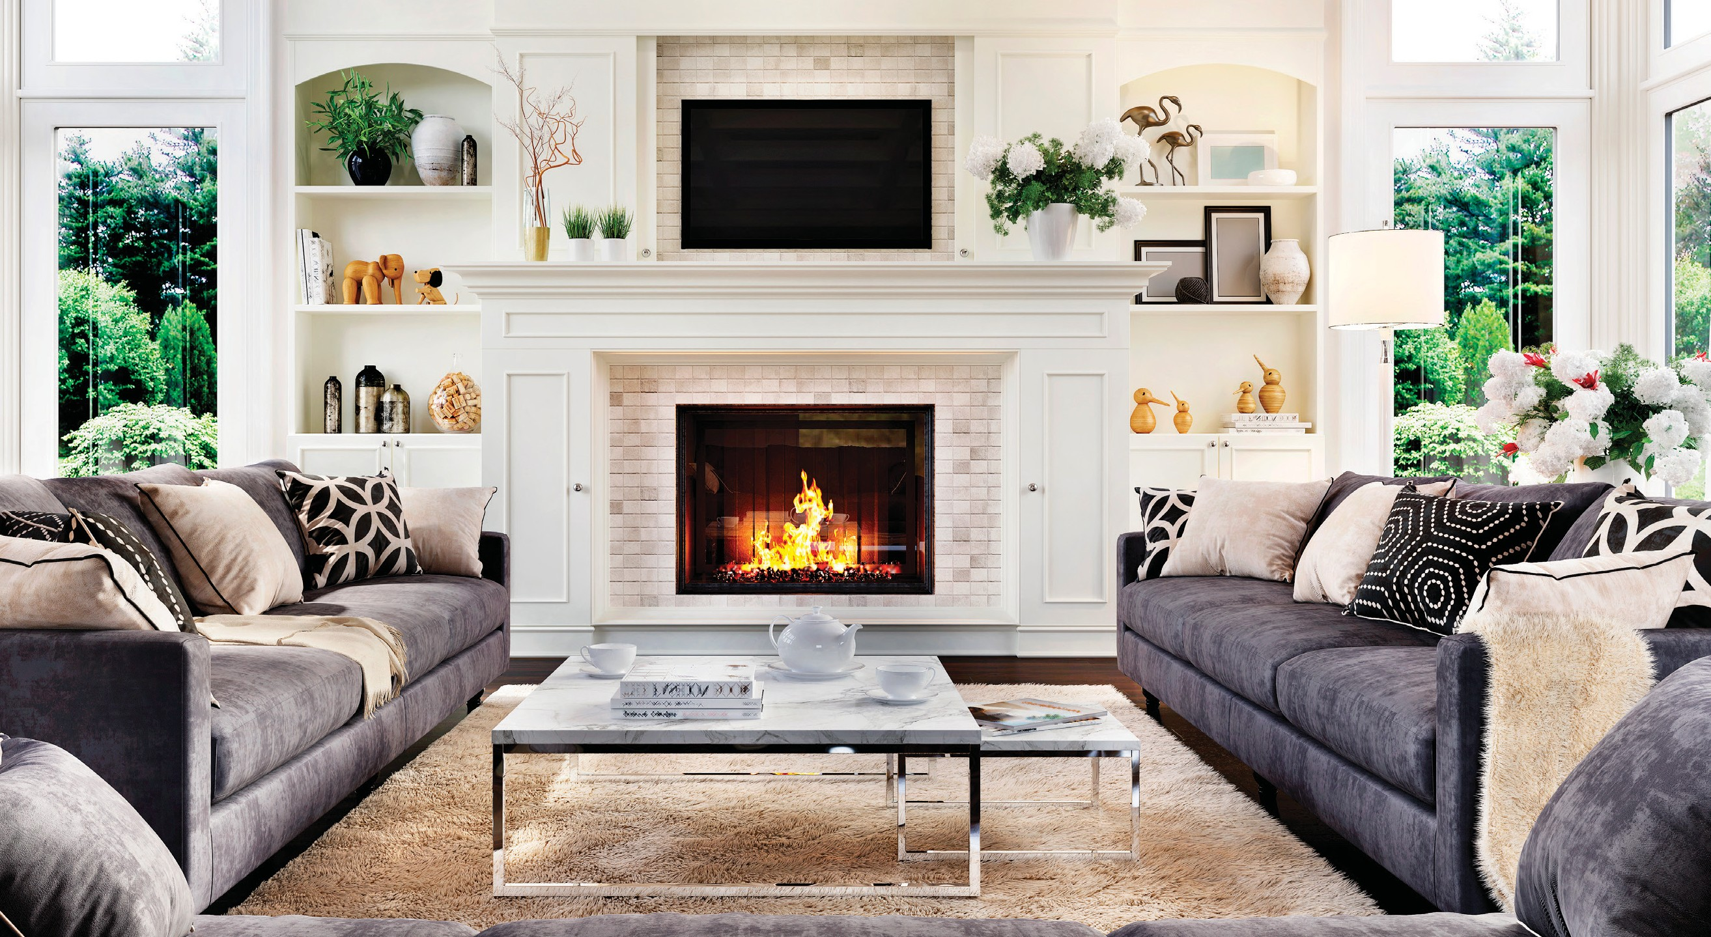
Simplify, Stage, and Clean
Reduce market time and maximize price
Being Market Ready, Day One™ is all about helping potential buyers visualize the property as their future home. Simplifying, staging, and cleaning are vital steps to maximizing your home’s appeal and starting the process for an effective digital presence.

Slide 9
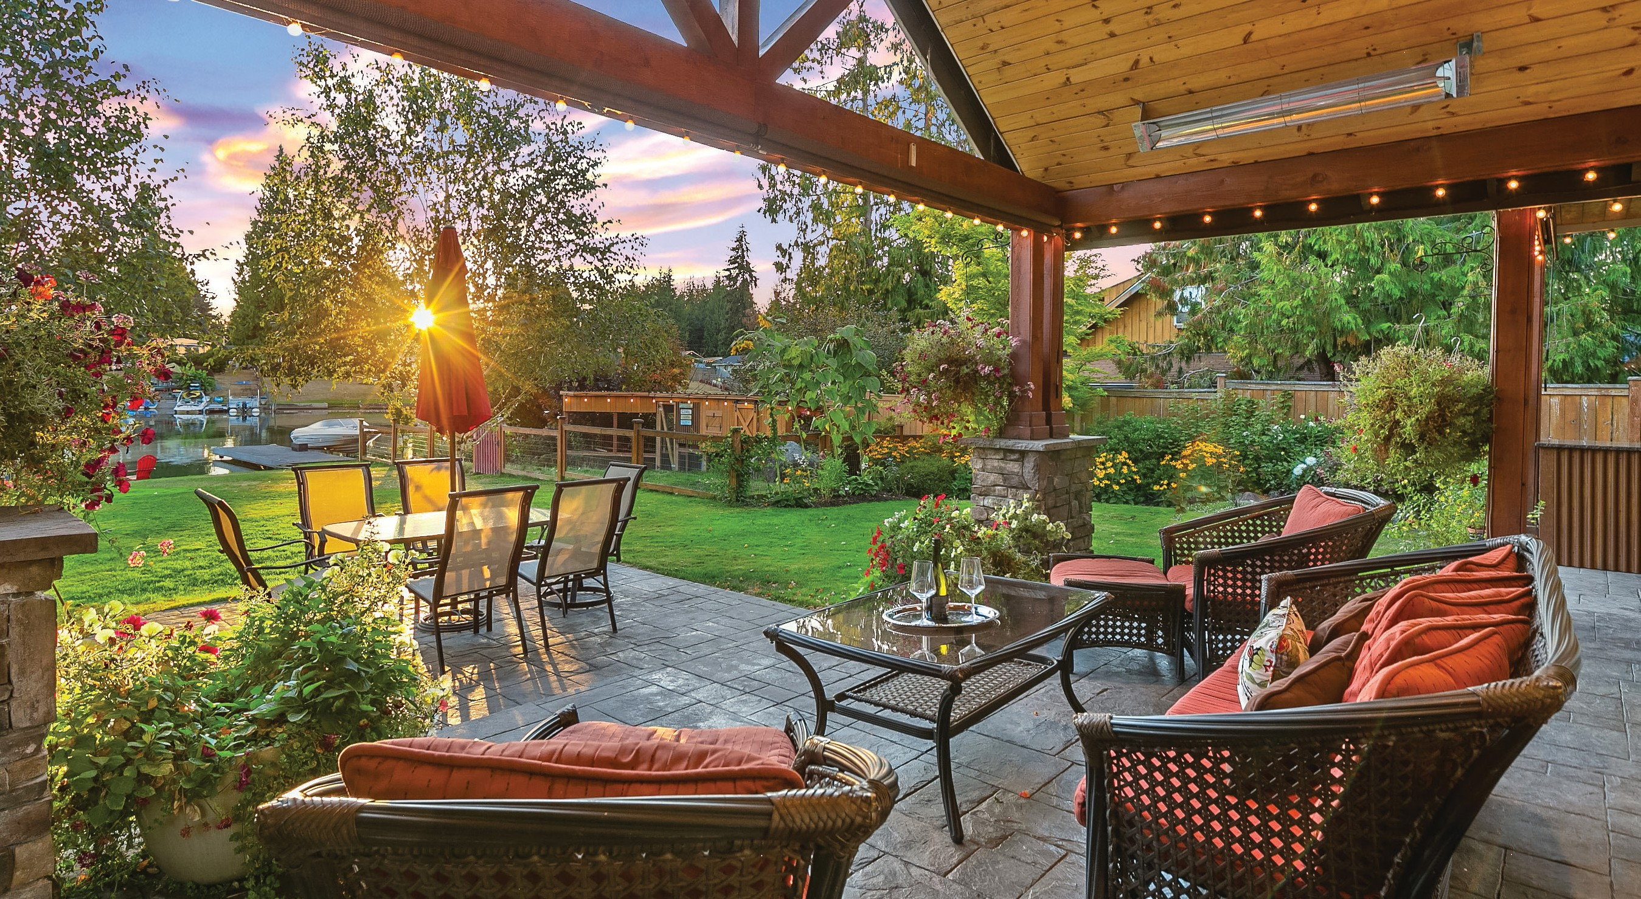
The Power of Professional Photography
95% of potential homebuyers will view your home online
Research shows that homes sell 32% faster when displaying professional photos. Our goal is to attract all potential homebuyers through photography, motivating them to take action and visit your home in person.
Photo by: Clarity Northwest Photography

Slide 10
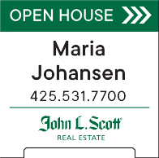
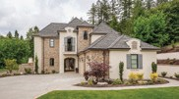
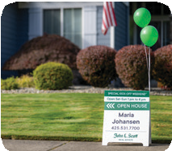
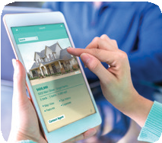
Comprehensive Marketing Strategy
We reach virtually every buyer through robust syndication, networking, personal connections, community outreach, and online exposure
The 19%
Signage and
Neighborhood Network
Maria Johansen
425.531.7700
mariajohansen.com
[franchise full license name or DBA] This office is independently owned and operated.
NEW LISTING This Saturday and Sunday ™ Open House 1 pm - 4 pm REAL ESTATE Offered at $750,000 65432 Main St., City, ST 98000 ^{BEAUTIFUL EDUCATION HILL HOME} FEATURES
Great value for this very large 5-bedroom home in Education Hill. Lots of room to entertain here, with a bonus room upstairs, family room on the main level and another rec room in the lower level, plus two outdoor decks. Kitchen has granite counters, attractive cabinetry and hardwood floors. 5-piece en suite master bath with soaking tub. Easy access to Redmond amenities and easy to commute to Microsoft. Lake Washington schools. Seller is painting the inside and installing new carpet. |  | Bedrooms: 5 Baths: 3.5 Square Feet: 3,910 Year Built: 1998 Neighborhood: Education Hill Acres: .32 Parking: 3- car garage Fireplaces: 1 Sauna Hottub View Photos johnlscott.com/12345
p: e: w: Some John L. Scott offices are independently owned and operated. *All listings may not be displayed in a specific marketplace as some Brokers or property owners may opt out.
19%
52%
The 29%
Broker Introduced
View Photos
Jordan Kingston
Broker
(555) 555-5555
jordankingston@johnlscott.com jordankingston.johnlscott.com
29%
OPEN HOUSES AND
BROKERS OPEN
BROKER TO BROKER
NETWORKING
Where buyers first found the home they purchased*
SELLER LISTING LAUNCH® POSTCARDS, FLYERS,
NEIGHBORHOOD INVITES
BROKER FILTER SEARCHES
AND SELECTIONS
BROKER WEBSITE AND
SOCIAL MEDIA
*National Association of Realtors® Data fluctuates, averages included

Slide 11
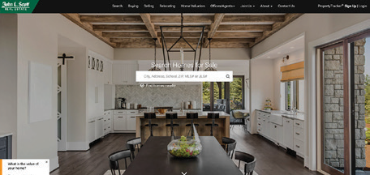
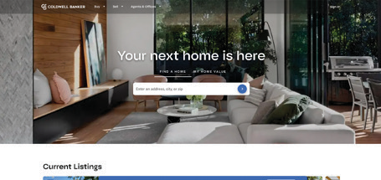
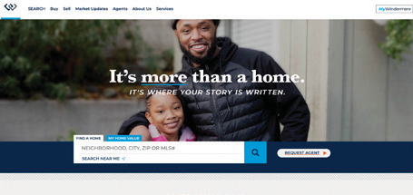
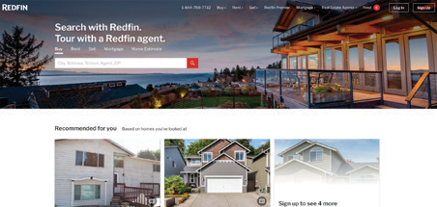
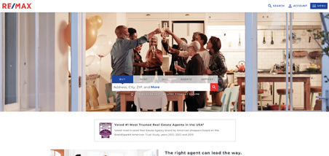
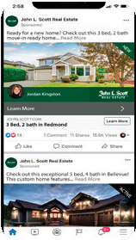
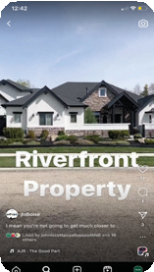
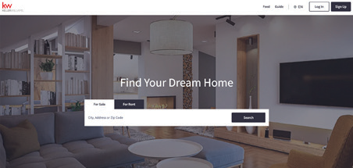
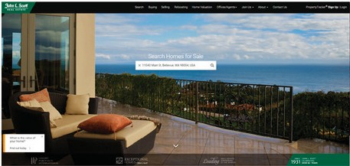
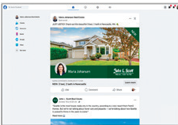
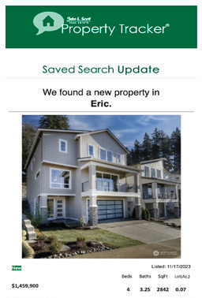
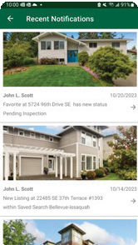
Maximizing Your Online Presence
Our approach is designed to showcase your home to the largest audience to leverage your position in the market and get you superior results
The 52%
The MLS and Syndication
THE JOHN L. SCOTT ADVANTAGE
GLOBAL PARTNERS
JOHN L. SCOTT PLATFORM
(johnlscott.com, PropertyTracker®, listing details page)
JOHN L. SCOTT NETWORK
(3000+ Broker Associates)
HOME
SEARCH APP
ALL REAL ESTATE WEBSITES
NATIONAL PORTALS
SOCIAL MEDIA
BOOST ADS
POSTS
REELS/STORIES
NOTIFICATIONS AND PROPERTY ALERTS
John L. Scott
New Listing at 8922 NE 173rd Place within Saved Search
Recommended for You
$700k • 2 beds • 1 bath • 1020 sqft 1234 50th Ave SW, Anytown, USA

Slide 12
Local Reach: An Experienced Network
Experience is the backbone of our business with over 90 years of real estate transactions. At John L. Scott, our innovative initiatives and tools maximize the power of our local, regional, and national presence to better serve our clients.
Over 3,000
Broker Associates
Recognized as one of the Top Real Estate Brands in the Nation
Residential Condominium New Construction Land
John L. Scott brokers are some of the top-producing brokers in
the industry
100+
Offices
Washington Oregon Idaho California
Over 30,000*
Yearly transactions
T3 Sixty
*Average over 10 years

Slide 13
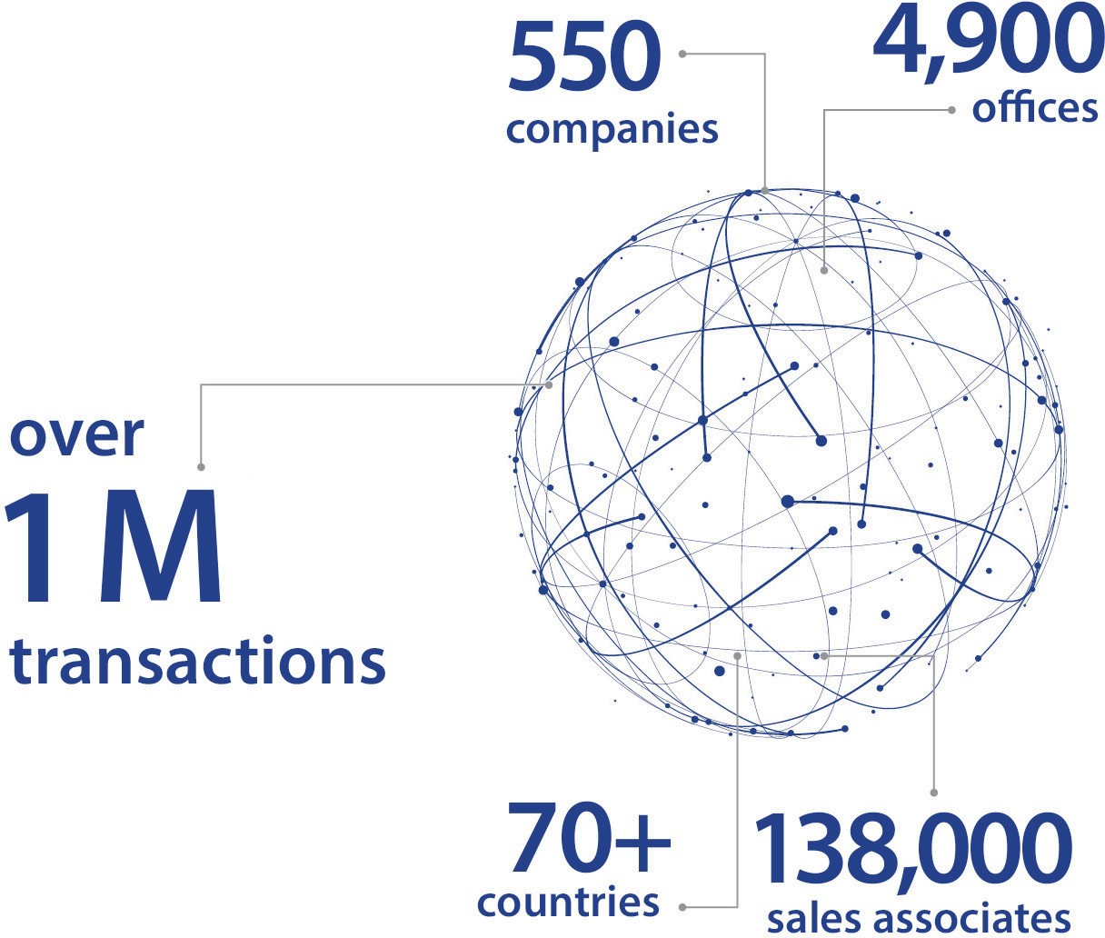
Global Reach:
Leading Real Estate Companies of the World®
We’re Local, We’re Global. We are a founding member of LeadingRE network, which is comprised of 550 companies representing over 70 countries and over 1 million transactions each year. We network and share all John L. Scott listings across the entire footprint to maximize exposure of your home.
U.S. HOME SALES VOLUME AMONG THE TOP 500 U.S. REAL ESTATE FIRMS
LEADINGRE +
JOHN L. SCOTT REAL ESTATE
$353
KELLER WILLIAMS
$312
2022 NETWORKS, FRANCHISES AND COMPANIES
$233
COLDWELL BANKER
COMPASS
SOTHEBY’S
INTERNATIONAL REALTY
BERKSHIRE HATHAWAY HOMESERVICES
$228
$124
$120
RE/MAX
$97
$32
$30
CENTURY 21
HOMESMART INTERNATIONAL
CORCORAN
$24
UNITED REAL ESTATE
$21
VOLUME SHOWN IN BILLIONS OF DOLLARS

Slide 14
Motivating Buyers to Take Action
Seller Listing Launch® is our exclusive, federally trademarked program.
John L. Scott understands how to market specifically to the backlog of buyers*
while connecting with new buyers just beginning their home search. Paired with Market Ready, Day One™, Seller Listing Launch® immediately motivates buyers to take action.
*Backlog of buyers:
The pool of buyers who are currently in the market searching for a home but have not yet purchased. These buyers are active in today’s market.

Slide 15
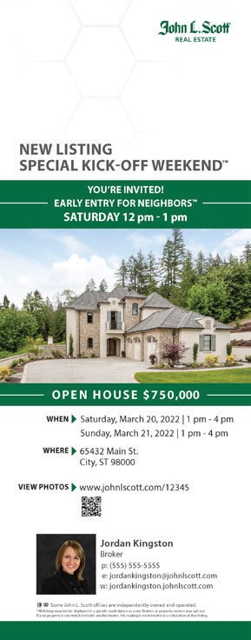
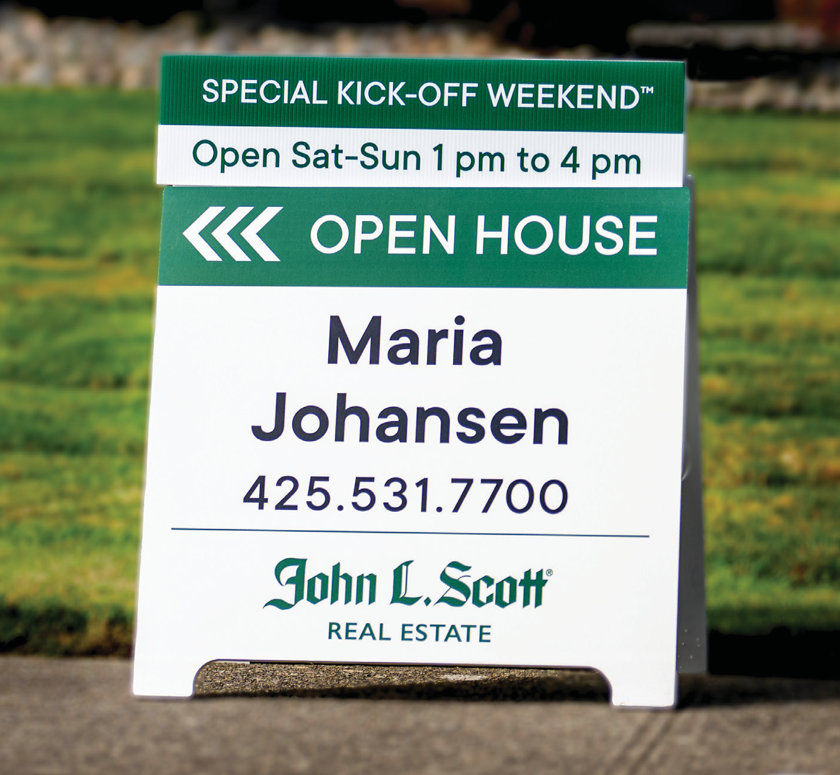
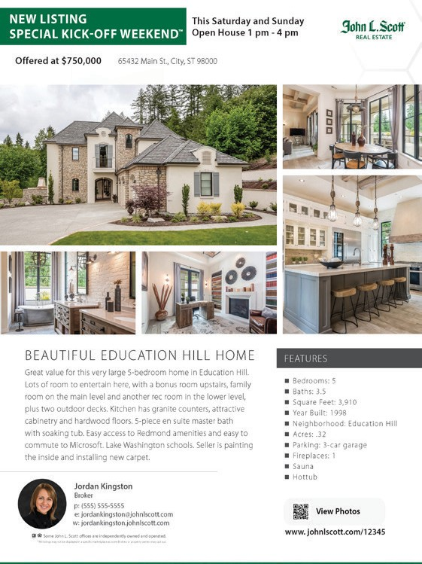
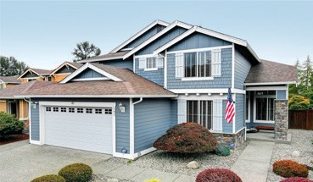
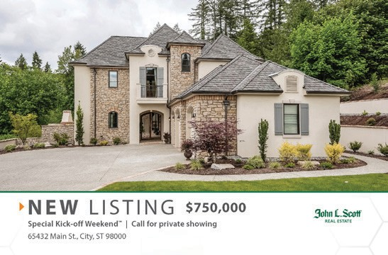
Seller Listing Launch®
The highest chance of selling your home at the best price is within the first 30 days on the market. That's why the launch is so important. We reach all potential buyers in the marketplace by generating momentum with the current backlog of buyers and attracting new buyers just beginning their home search.
Know anyone who wants to mov
If you know someone in the market to you please share this listing wit
Questions? Let’s talk today!
View Photos www.
John L. Scott
65432 Main St.
City, ST 98000
e into the neighborhood?
interested in living close h them!
johnlscott.com/12345
Jordan Kingston
Broker
p: (555) 555-5555
e: jordankingston@johnlscott.com
w: jordankingston.johnlscott.com
Some John L. Scott offices are independently owned and operated.
*All listings may not be displayed in a specific marketplace as some Brokers or property owners may opt out.
If your property is currently listed with another broker, this mailing is not intended as a solicitation of that listing.

Slide 16
Home Pricing Strategies
The first 30 days after you list your home gives you a “seller negotiation advantage” with the backlog of buyers. Strategic pricing will help you attract the largest pool of prospective buyers. Many factors contribute to pricing your home:
Condition
Location
Price Range
Seasonality
Sales Activity Intensity™
New Listing Inventory
Months of Unsold Inventory
Sales Price to List Price Ratios
HOW DOES THE MARKET AFFECT YOU?
BUYERS MARKET
Selective Buyer Activity Intensity™
HEALTHY MARKET
Healthy Sales Activity Intensity™
SELLERS MARKET
High Sales Activity Intensity™
✴ More than 5 months of inventory
✴ More homes available for sale
As a seller, that means….
✴ Increase in listing competition
✴ Dispersed buyer energy
✴ Flat or softening of home prices
✴ 3-4 months of inventory is considered a healthy market
✴ 2 months or less of inventory
✴ Low or shortage supply of unsold inventory
As a seller, that means….
✴ Healthy supply of homes for sale
✴ Healthy buyer demand
As a seller, that means….
✴ Decrease in listing competition
✴ Increase of multiple offers
✴ Upper pressure of home prices

Slide 17
Sales Activity Intensity™
John L. Scott's exclusive Sales Activity Intensity™ reporting tracks and analyzes buyer sales activity to help us strategically price your home.
Percentage of NEW listings in a healthy market that go under contract each month
20% - 40%
100%
40
30 - 35% +
35
30
25
Sales price to list price percentage
Sales price to list price
95%
20
15
WEEK 1
WEEK 2
8 - 11%
10
WEEK 3
WEEK 4
6 - 7%
90%
5
3 - 4%
3 - 4%
2 - 4%
0
MONTH 1 MONTH 2 MONTH 3 MONTH 4 MONTH 5
Days on market before mutual acceptance
John L. Scott and MLS data is (+/-) based on existing home sales.
MONTH 6
DID NOT SELL DURING FIRST SIX MONTHS

Slide 18
Understanding the Transaction Process
Knowing the negotiation points in the real estate transaction journey helps us partner together to reach your goals
1
RECEIVING
2
AN
PURCHASE AND SALE
AGREEMENT NEGOTIATIONS
11
OFFER
CLOSING DAY AND
POSSESSION
3
MUTUAL
ACCEPTANCE
10
ESCROW
FINAL SIGNING
4
OPEN ESCROW AND
EARNEST MONEY DEPOSIT
9
BUYER WALK-THROUGH AND CONFIRM REPAIRS
5
8
TITLE REVIEW
FINANCING AND
APPRAISAL
6
7
HOME
INSPECTION
NEGOTIATE
CONTINGENCIES

Slide 19
A Successful Negotiation
Achieving the best price and terms
There are many points in a real estate transaction that are complex and need expert negotiation. We believe in negotiating the terms that matter most to you.

Slide 20
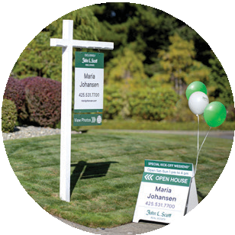
The Home Selling Journey
From Start to Mutual Acceptance
Options:
Seller Pre-inspection (Home) Septic / Sewer Inspection Well Testing
Special Assessments Collecting HOA Documents
HOME WALKTHROUGH
SELLER CONSULTATION
SIGN LISTING AGREEMENT
HOME REPAIRS, TOUCH UPS AND YARD
SIMPLIFY AND PACKING BEGINS
CLEANING AND STAGING
LIST HOME ON MLS
PREP MARKETING MATERIALS
PHOTOGRAPHY AND
ONLINE TOURS
SELLER LISTING LAUNCH®
SELLER COMMUNICATION
OFFER RECEIVED AND NEGOTIATION
OPEN HOUSES AND SHOWING
MUTUAL ACCEPTANCE

Slide 21
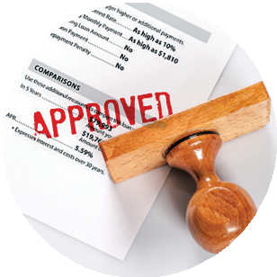
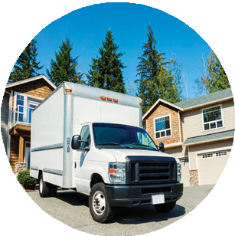
The Home Selling Journey
From Mutual Acceptance to Closing
FUNDS DELIVERED TO SELLER
EARNEST MONEY DEPOSIT CONFIRMATION
APPRAISAL
SIGN CLOSING DOCUMENTS

HOME INSPECTION
Options:
Septic / Sewer Inspection Feasibility
Radon
Well Testing HOA Documents
Lead Based Paint Testing Additional Inspections
BUYER WALKTHROUGH
VACATE HOME AND UTILITY TRANSFER
LOAN APPROVAL
STAGING REMOVAL
KEY EXCHANGE
PACK HOME
MOVE OUT HOUSE CLEANING
PROPERTY TRANSFER DAY (FUNDS SENT TO SELLER)
SCHEDULE MOVERS

Slide 22
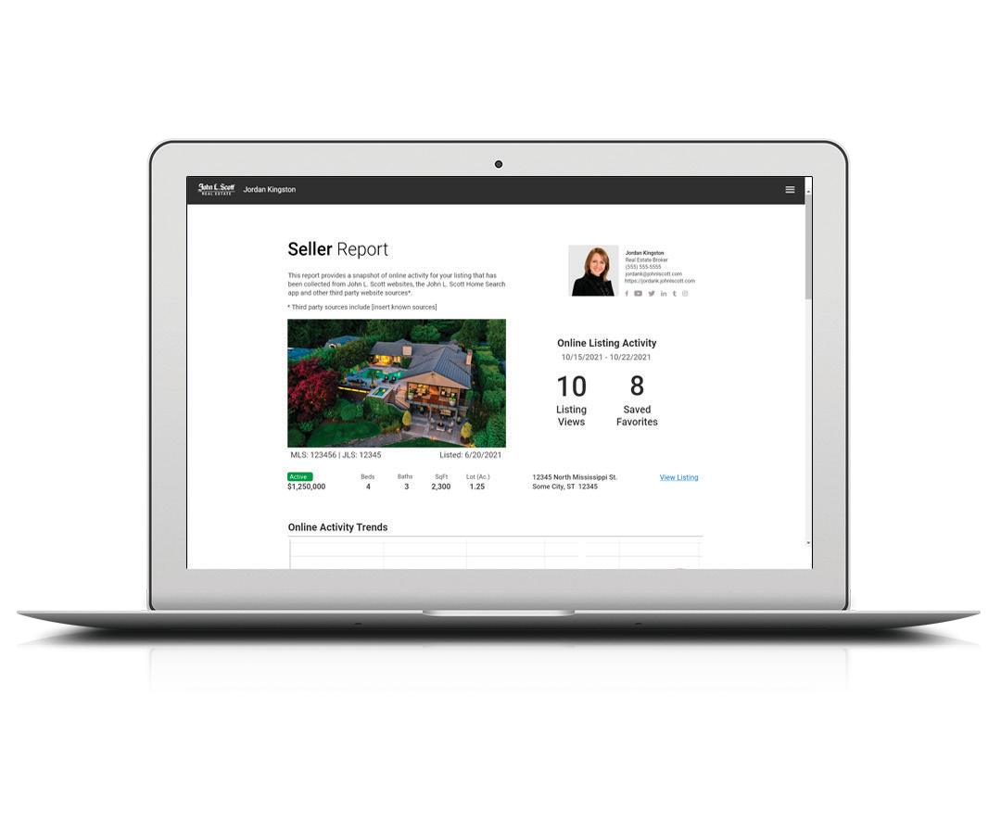
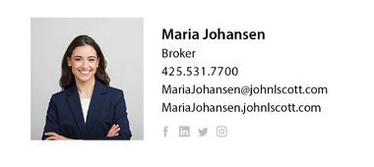
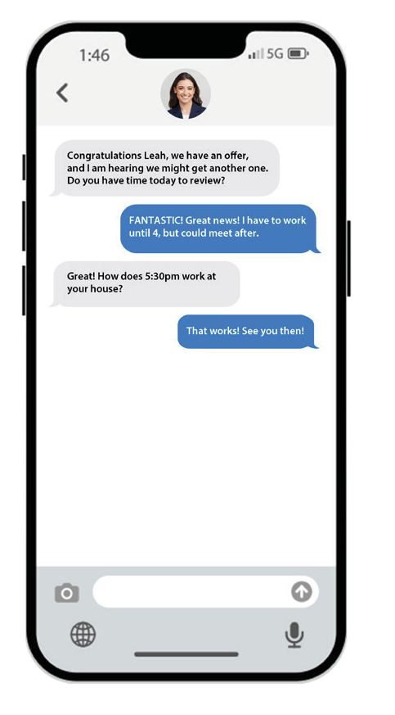
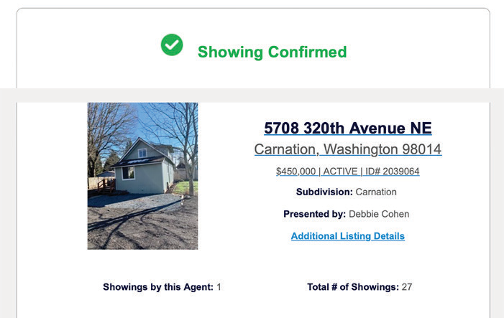
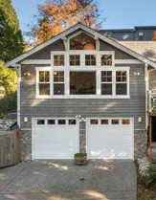
Our Communication Commitment
Ongoing communication throughout the entire process
Keeping you informed will help you make decisions throughout the home selling journey. As your personal representative, we will keep you informed on changing market conditions, buyer activity, and every step of the transaction process.
Subdivision: Main Street
Presented by: Maria Johansen
1254 Main Street
Anytown, USA 98765
List price $699,000

Slide 23
Thank You
The time you've taken to go through this guide and better understand the home selling process and strategies is vital to our success.
John L. Scott is committed to you and getting your home sold at the best price and terms.

Slide 24
Helping Kids Get Healthy and Be at Home
SUPPORTING OUR COMMUNITY
LAST YEAR
THE JOHN L. SCOTT FOUNDATION
HELPED SPONSOR
30 ^{FOR} 17
EVENTS HOSPITALS
WHICH HELPED RAISE NEARLY
$20 MILLION
FOR CHILDREN’S HEALTHCARE
3,500
MEALS SERVED AT
RONALD MCDONALD HOUSES
Living Life as a Contribution®
is our core value at John L. Scott
johnlscottfoundation.org

