Slide 1


STEPS TO SELLING SUCESS
With John L. Scott Team TMG

Slide 2

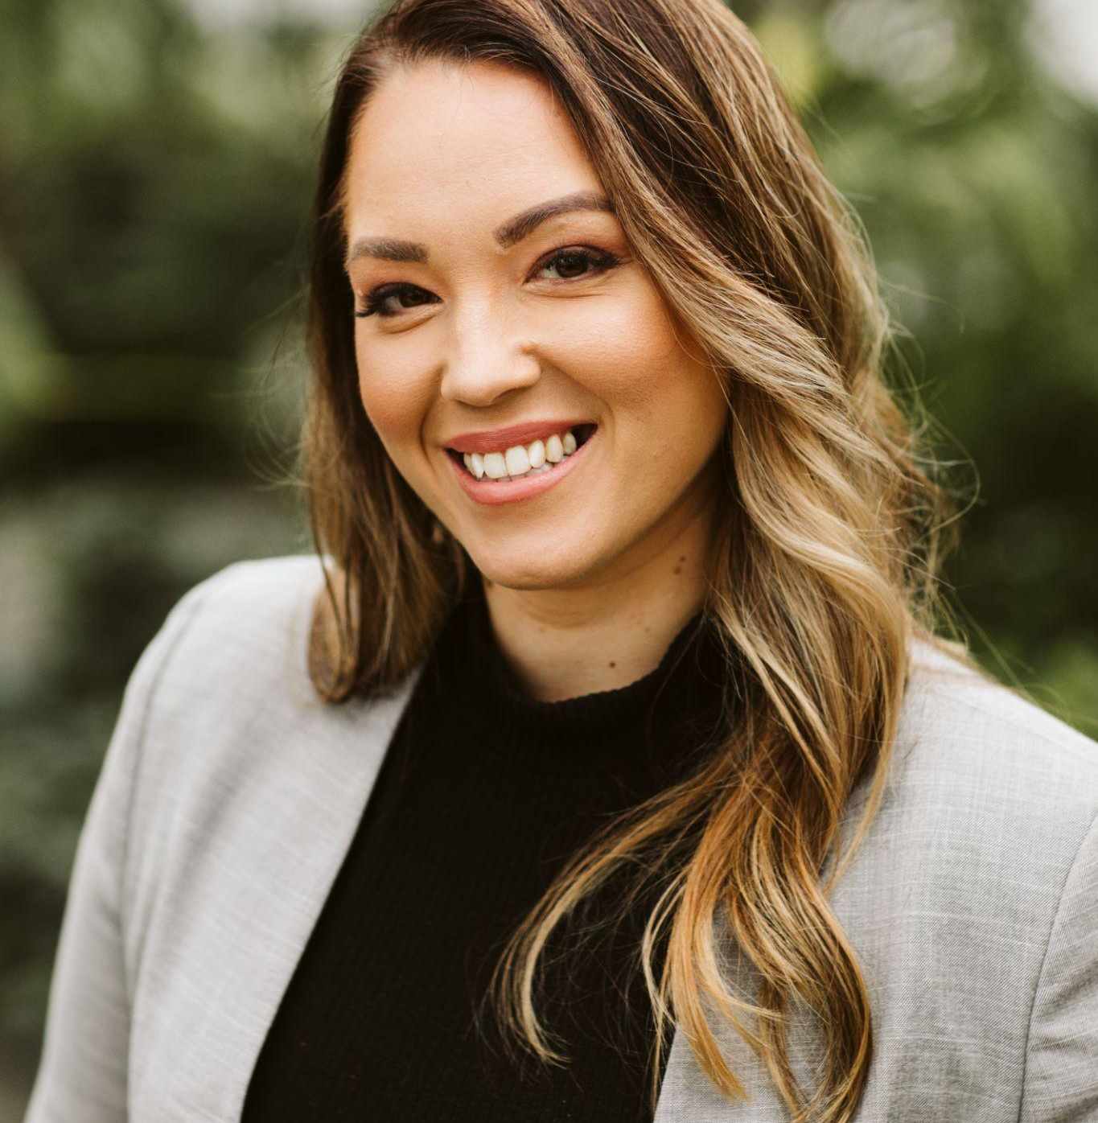

LET US FOCUS ON YOUR GOALS
We Want To Make This A Big Deal
OUR PROFESSIONAL PURPOSE IS TO HELP YOU ACHIEVE YOUR GOALS
Preview Your Home
Discuss Your Needs
Review Comparable Properties & Current Market Trends
Determine Pricing and Estimate of Net
Create a Marketing Plan
List Your Home
This Is All About YOU!

Slide 3
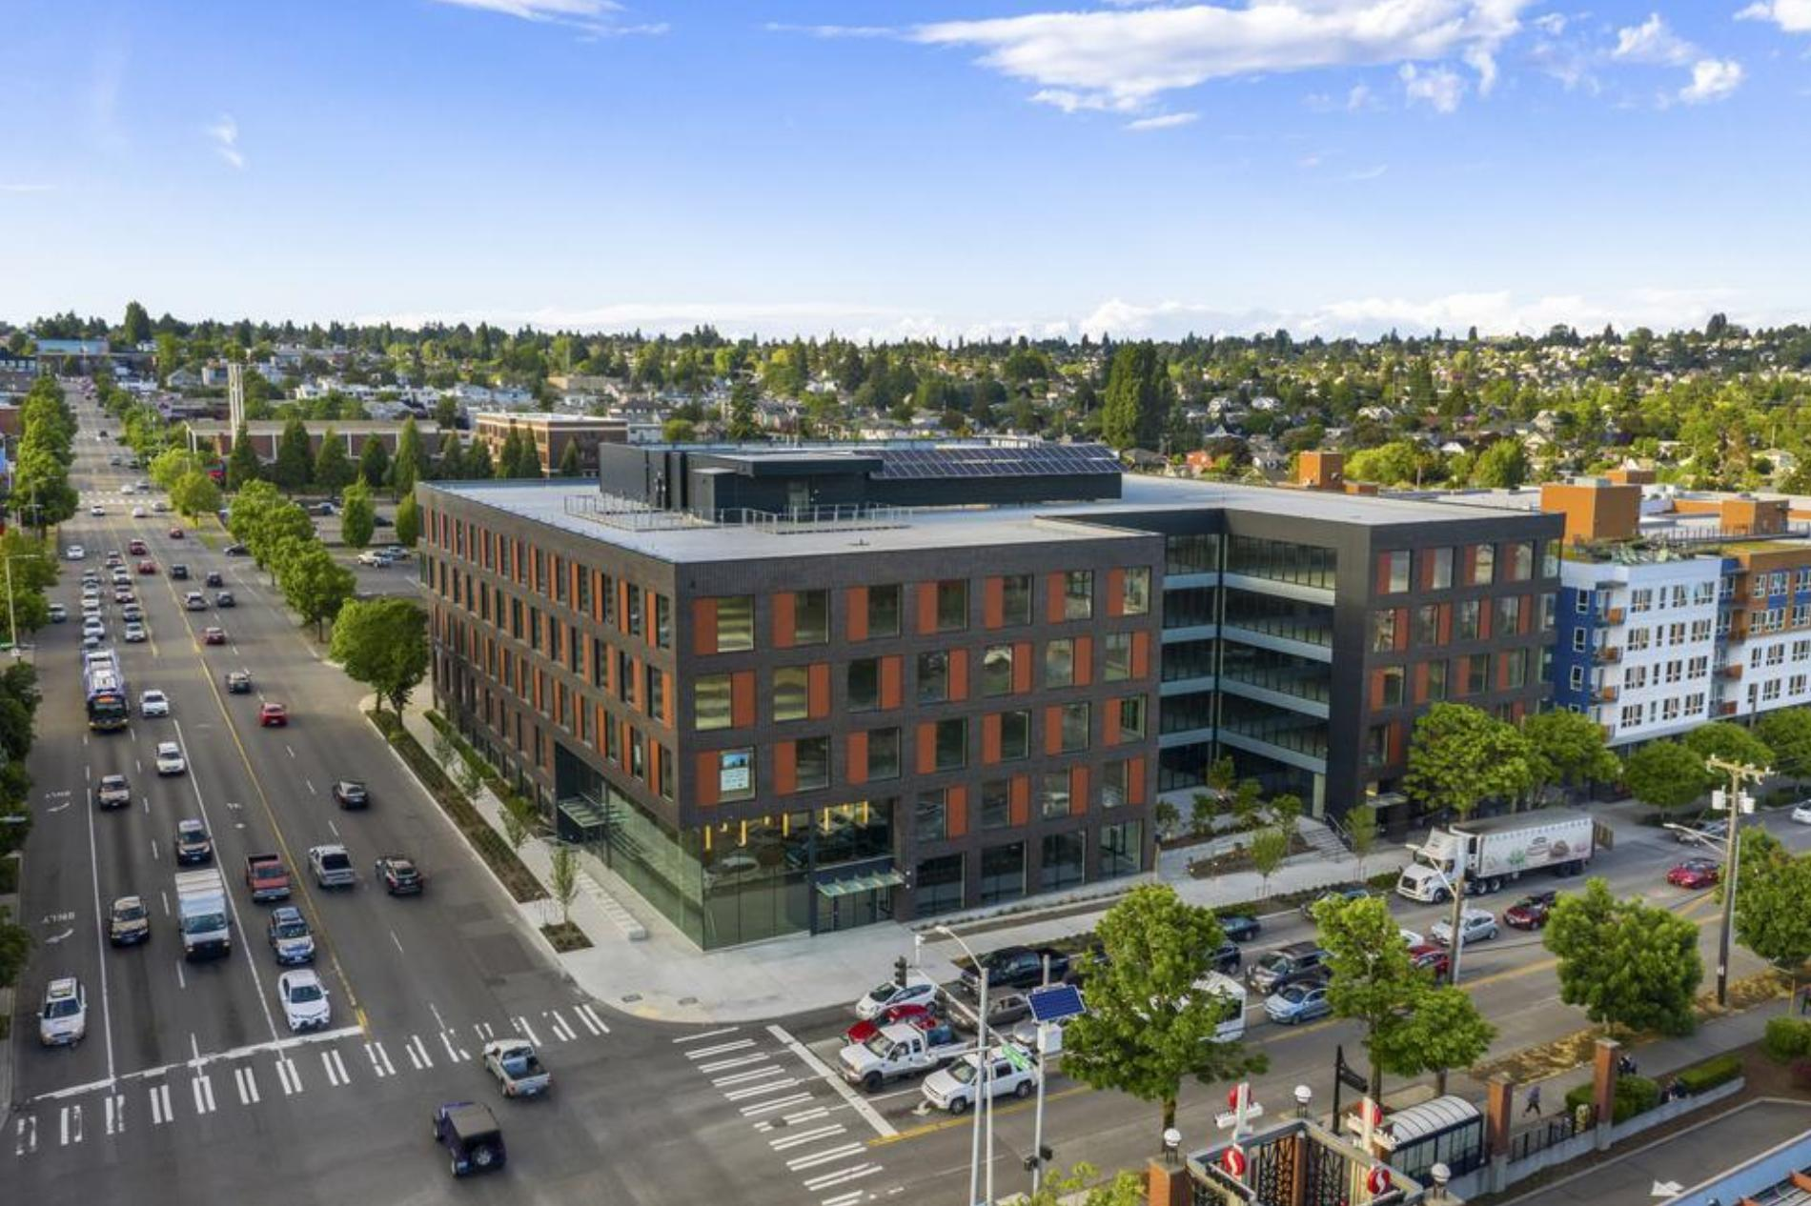
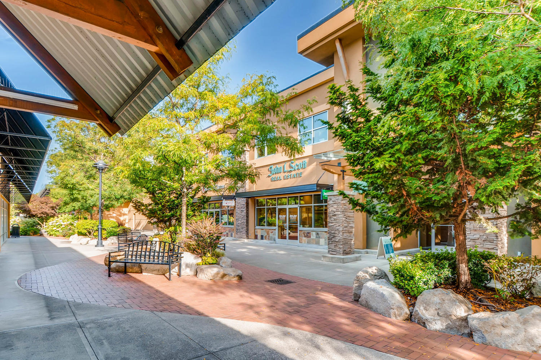
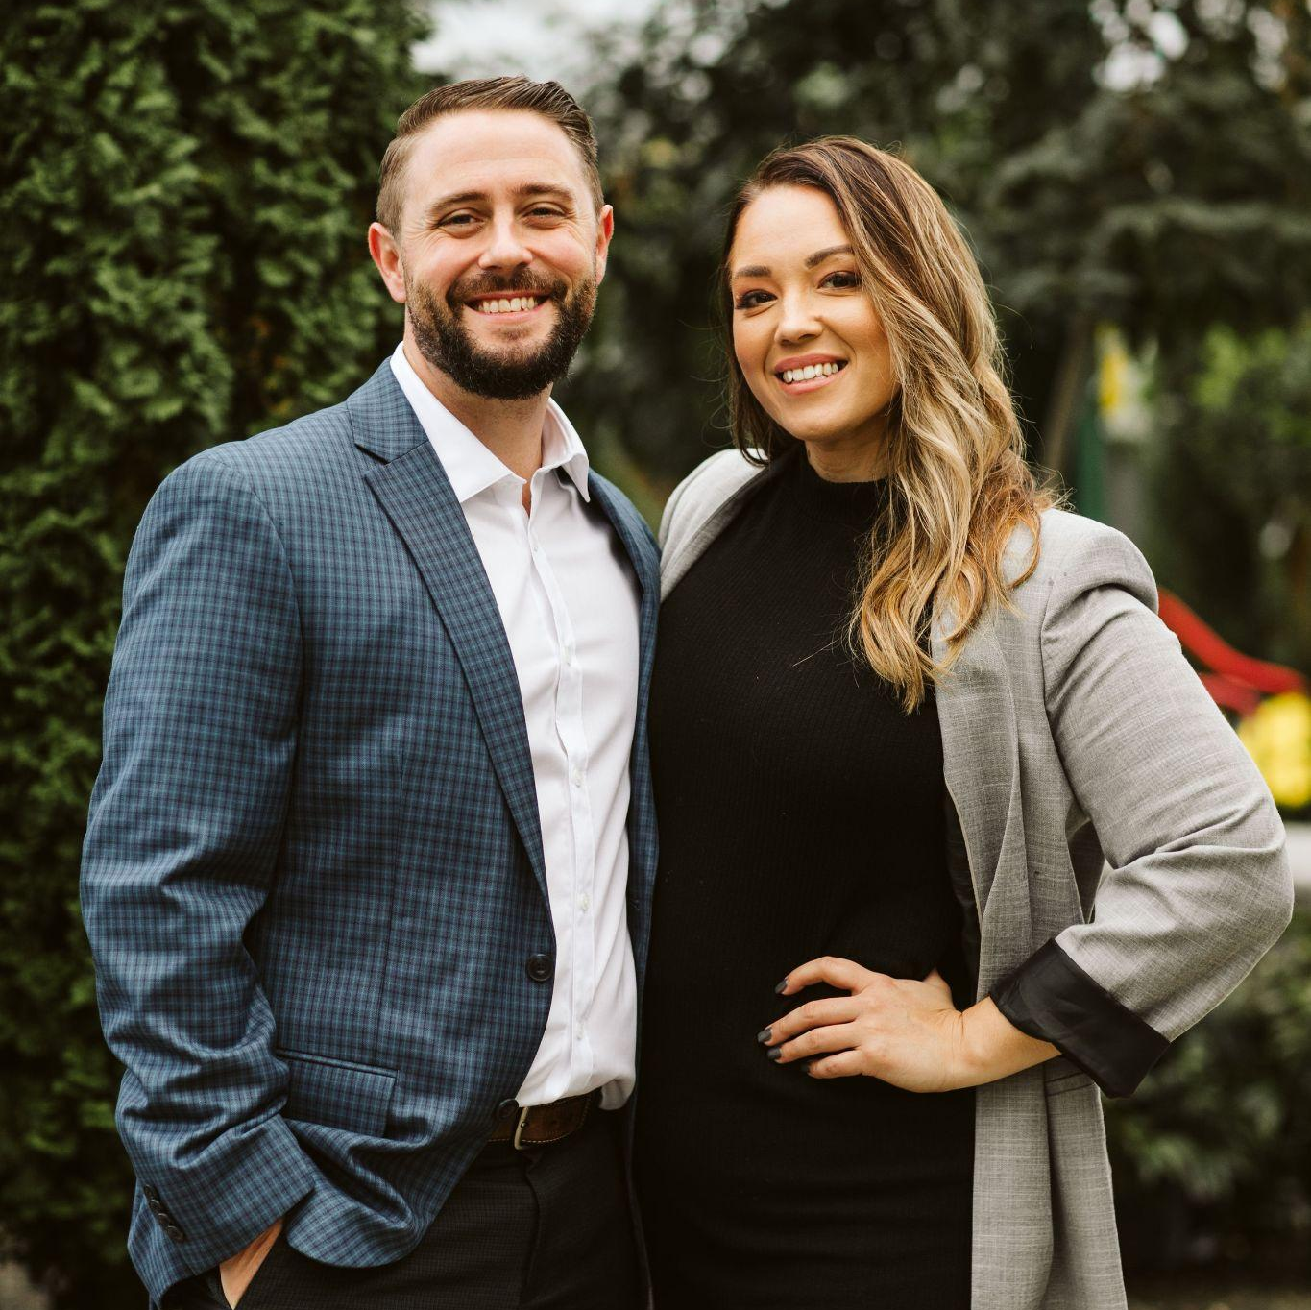
THE MADRONA GROUP
ADVICE FROM A TREE
John L. Scott Ballard + John L. Scott Westwood + Team TMG
The Madrona Group, Inc Is a Hub and Spoke Real Estate Model Serving [ Agents + Clients ] Where They Are.
“Stand tall and proud.
Sink your roots into the Earth.
Be content with your natural beauty.
Go out on a limb.
Drink plenty of water.
Remember your roots.
Enjoy the view!”
~ Ilan Shamir
Jason Fox and Joe Kiser
Founded The Madrona Group to be a virtual first, world class real estate brand, created for agents by agents.

Slide 4
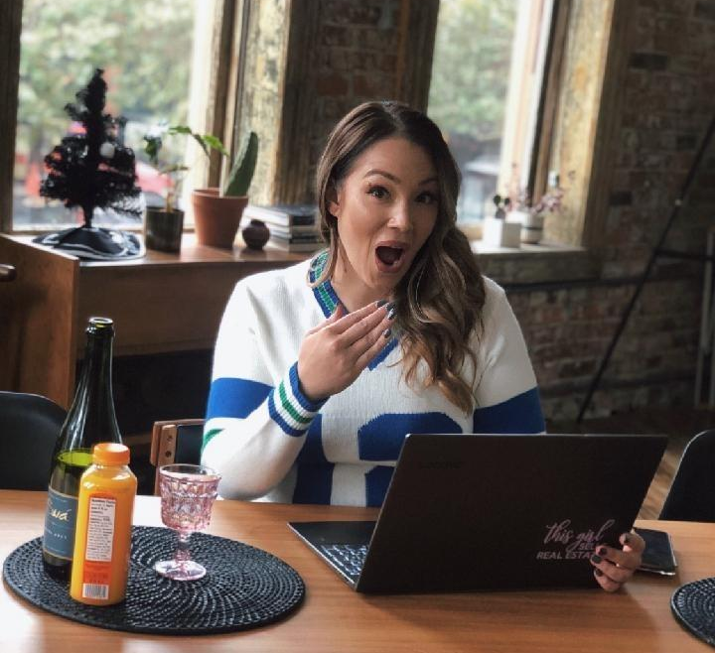
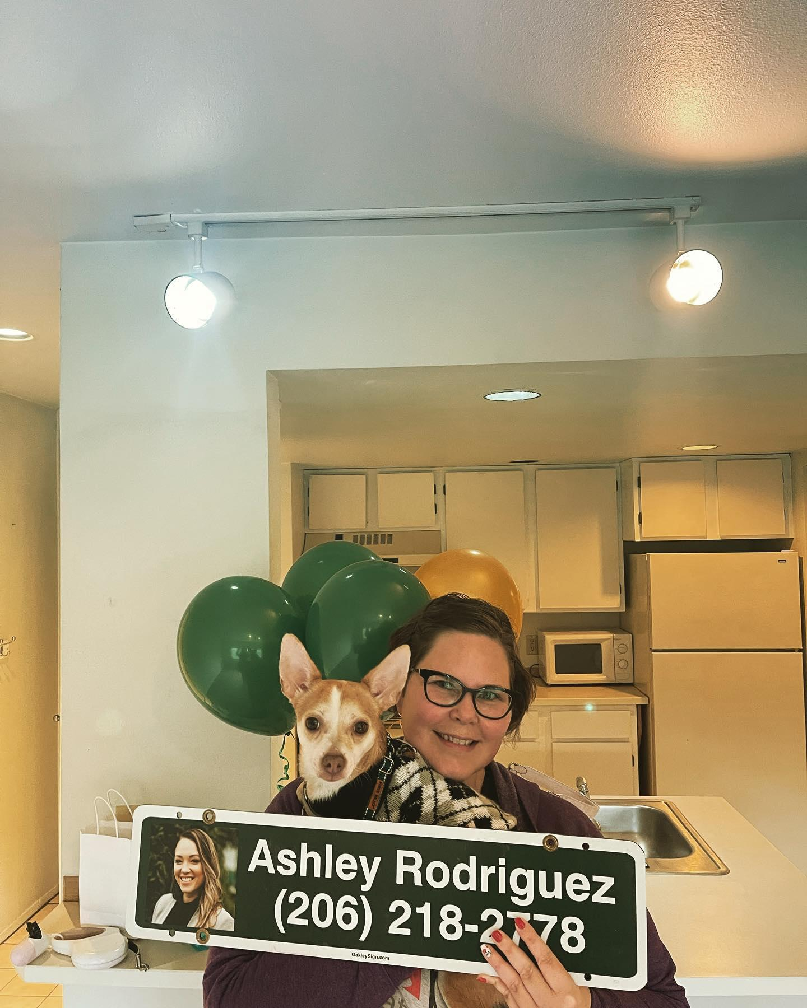
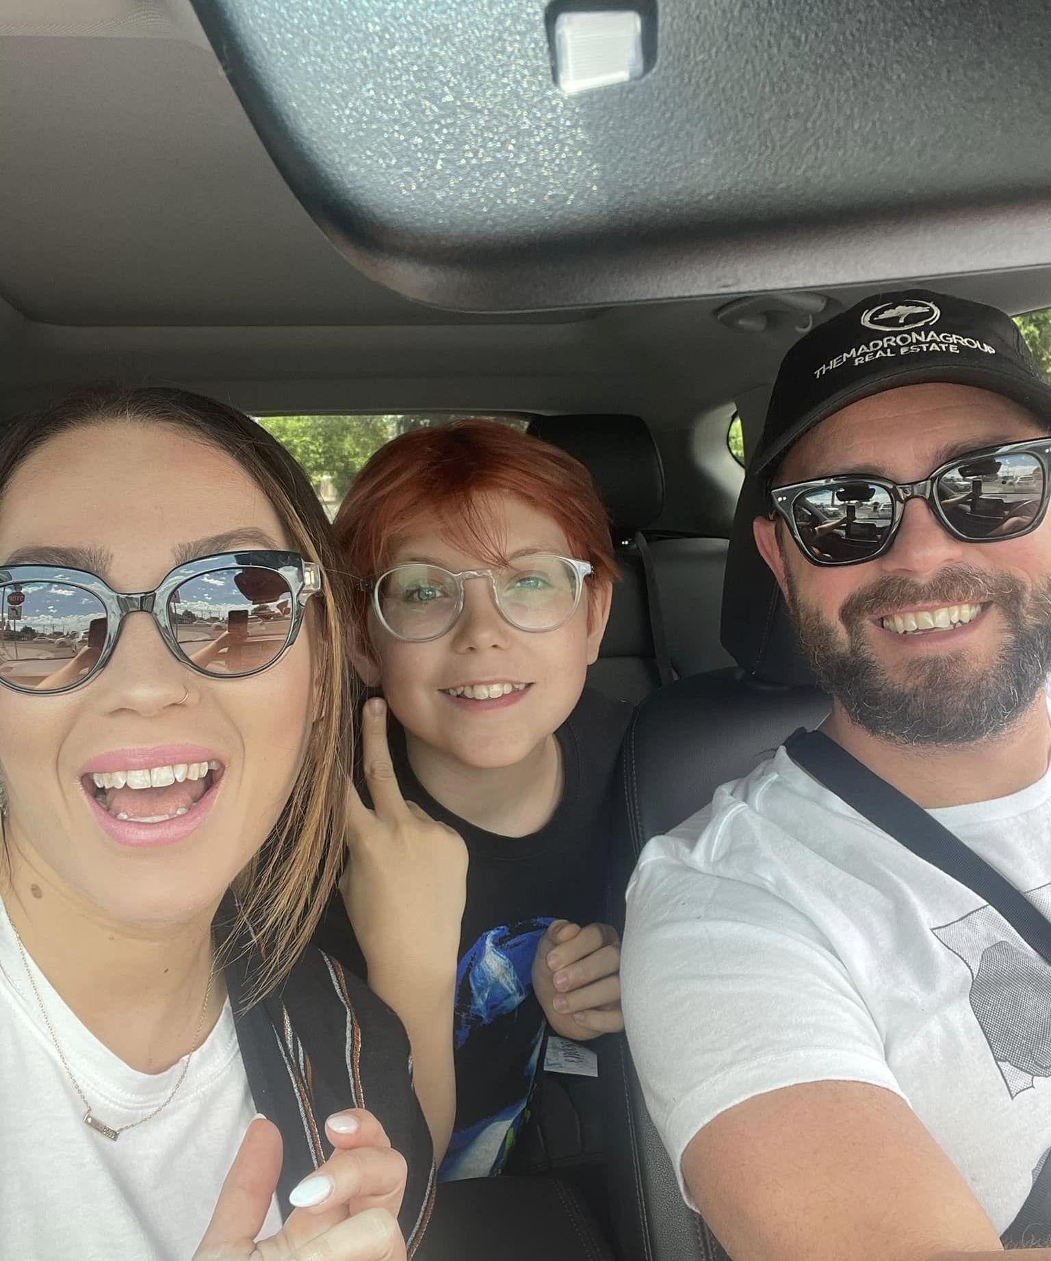
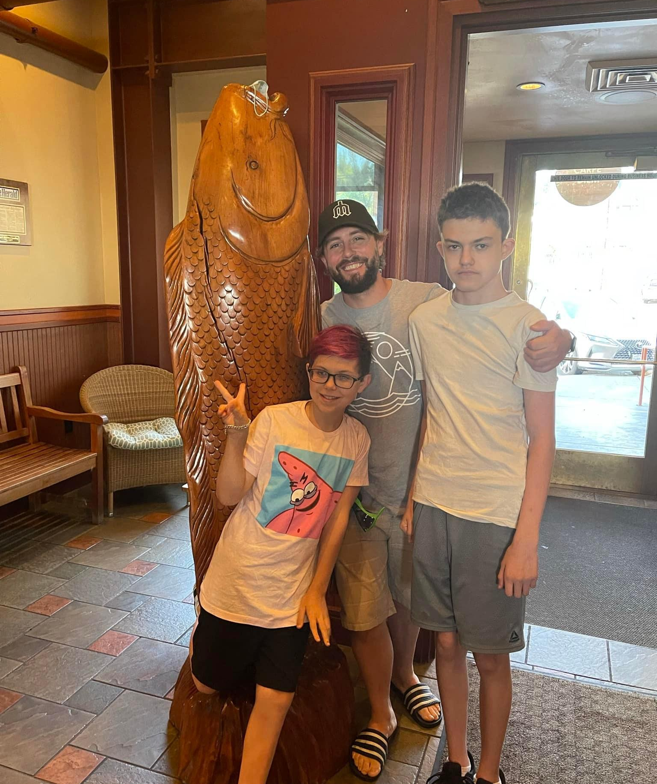
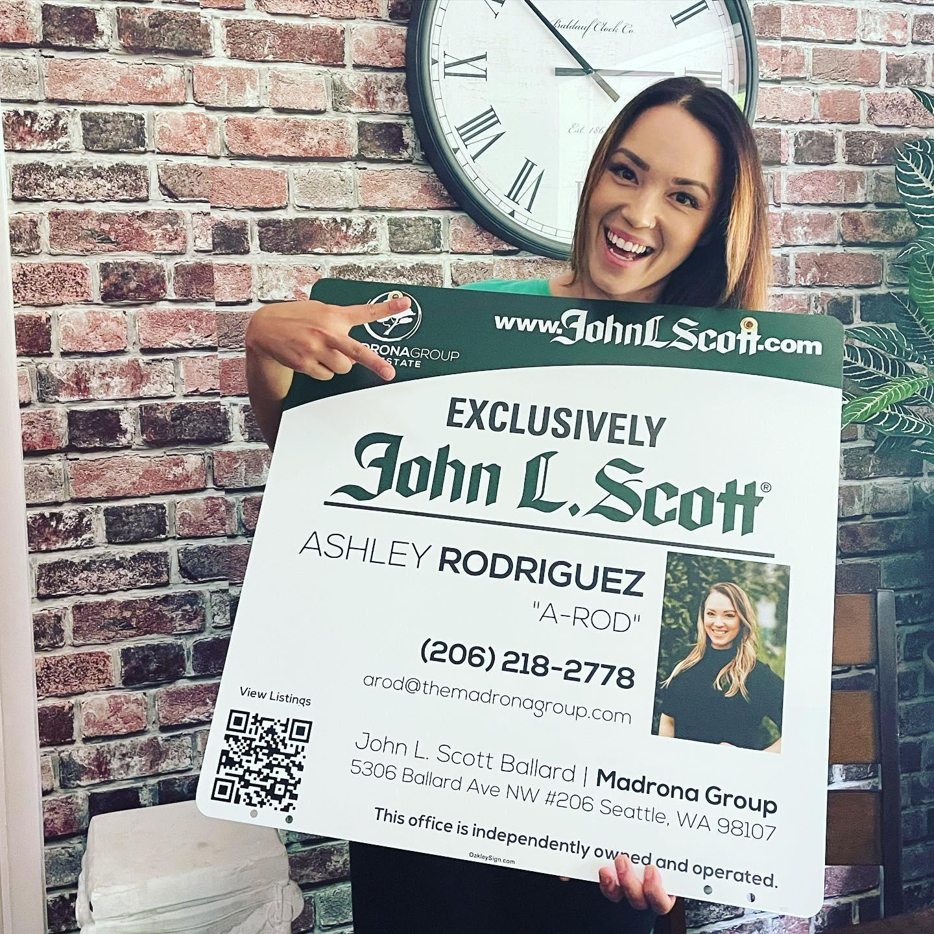
MEET ARod!

Slide 5
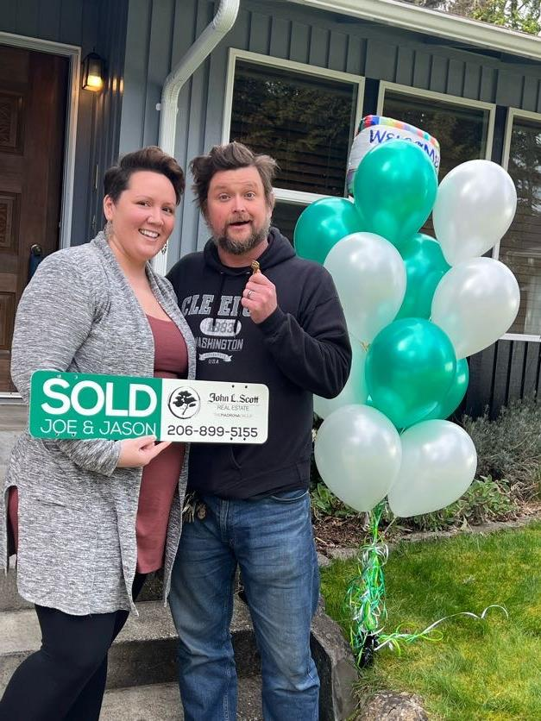
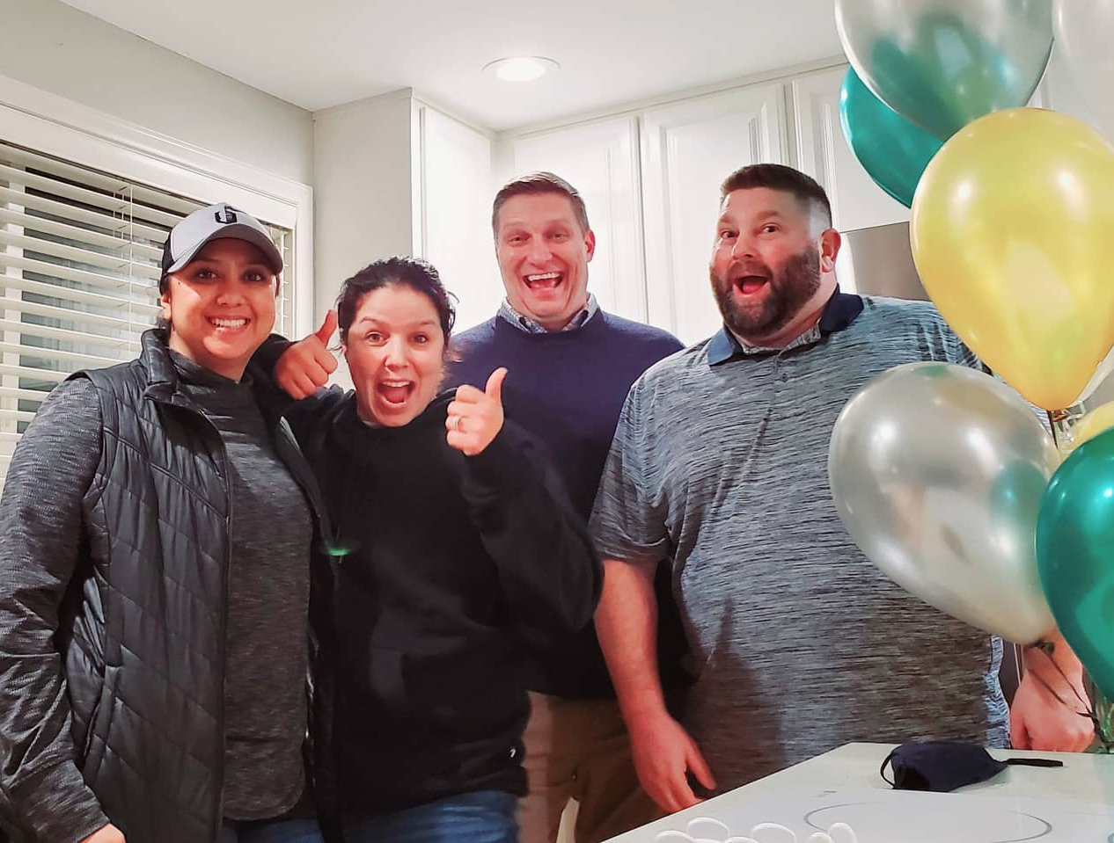
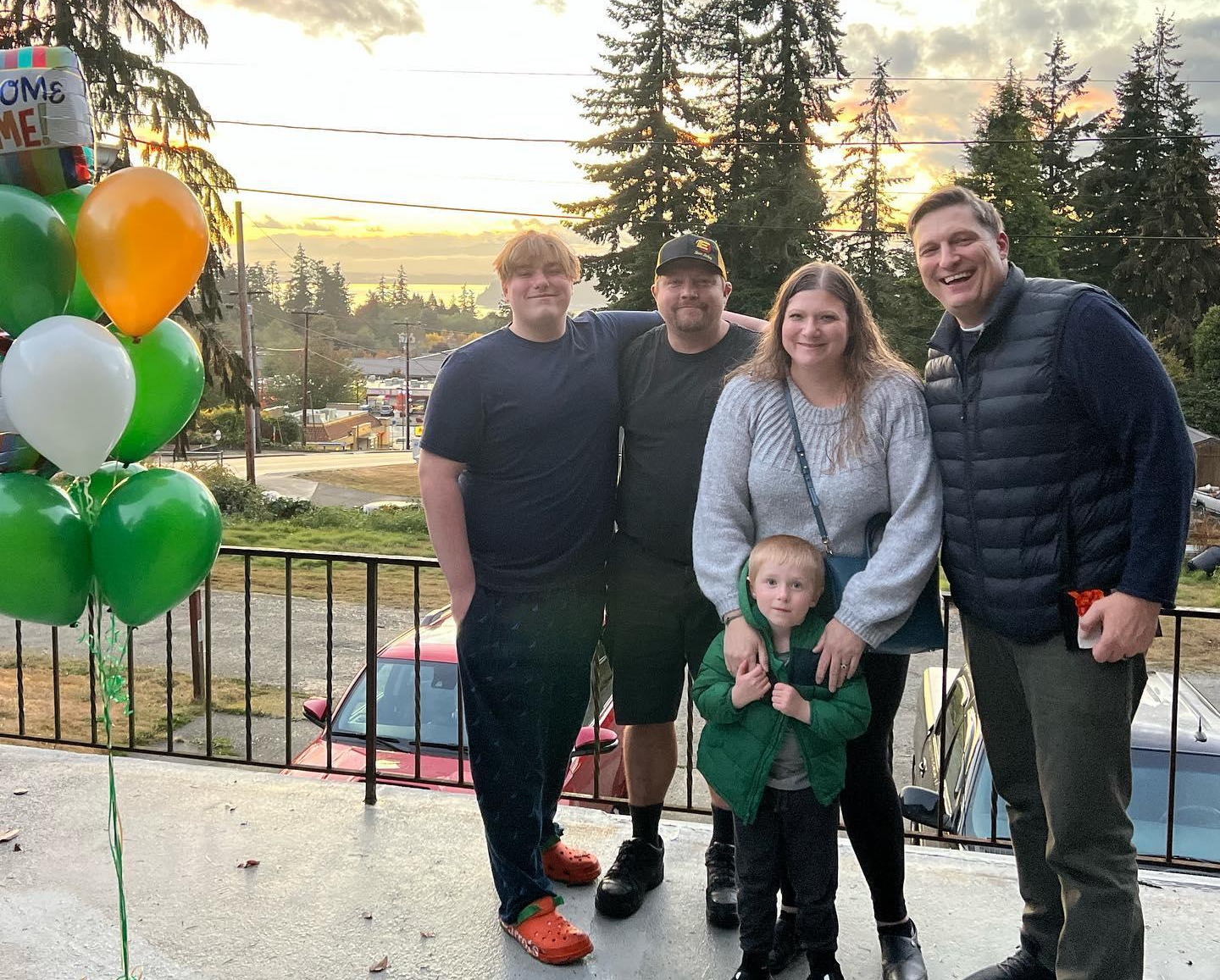


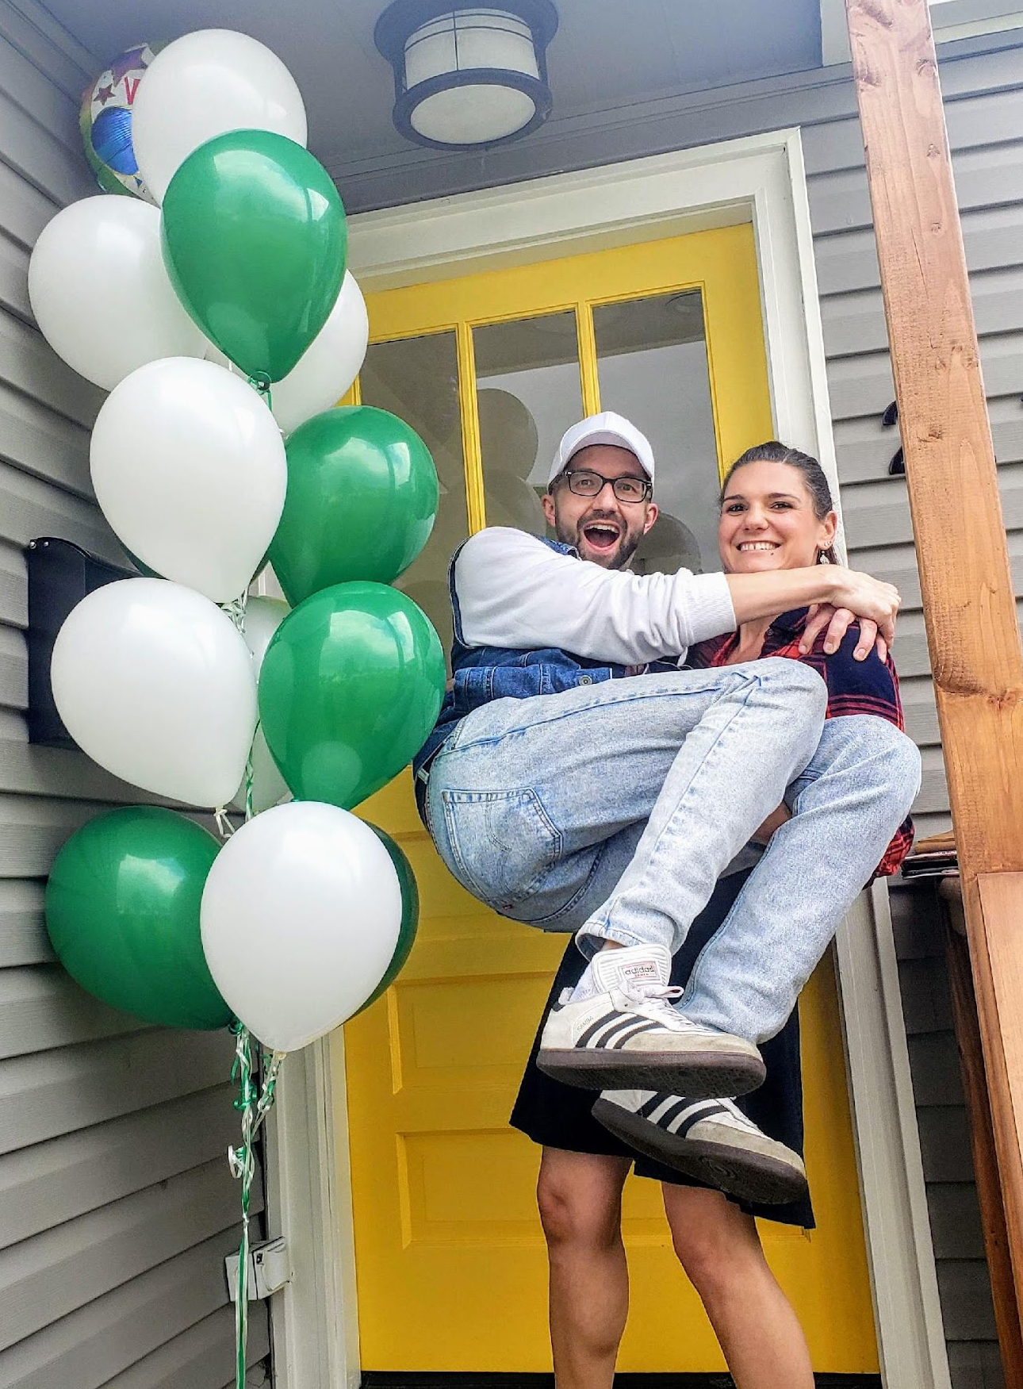
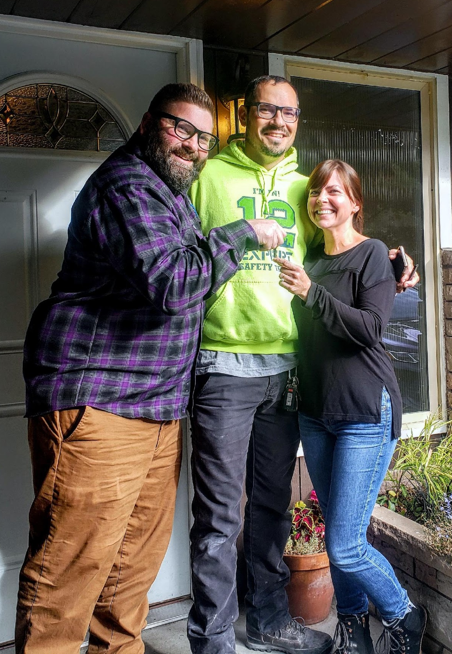
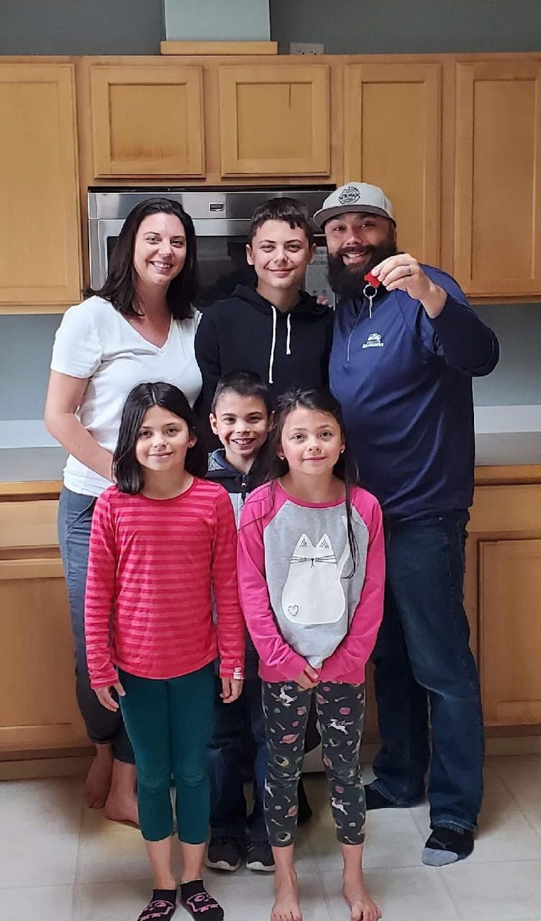
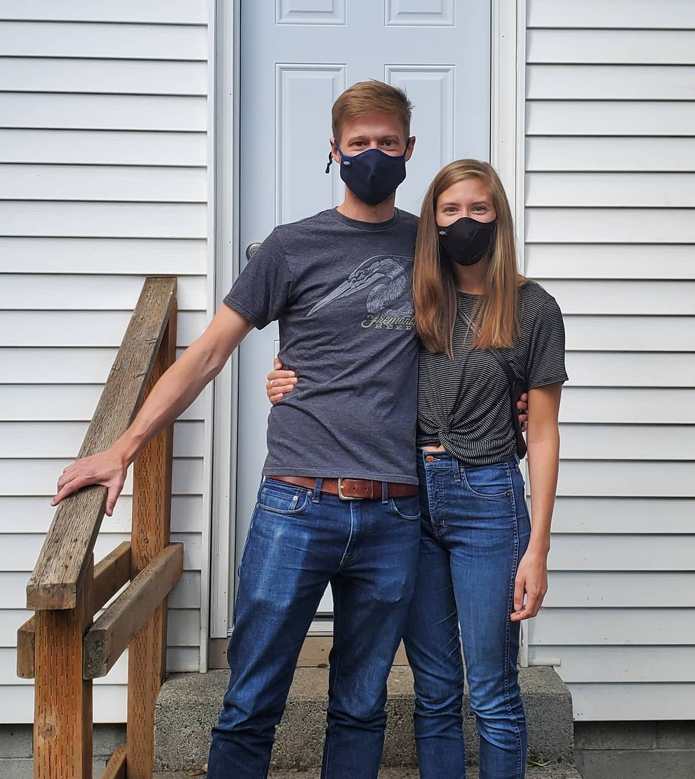
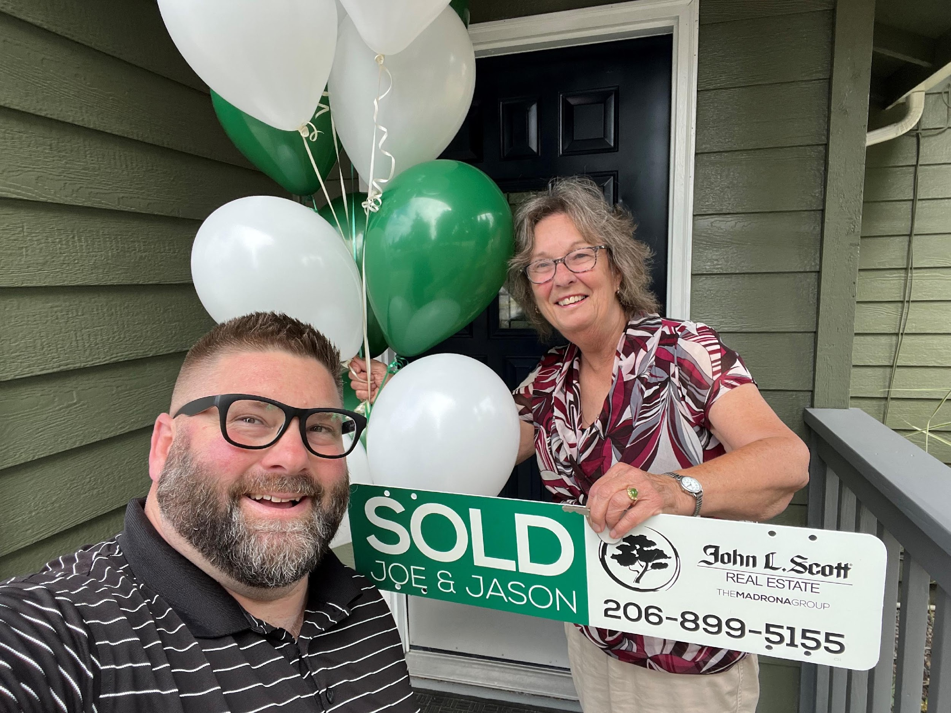

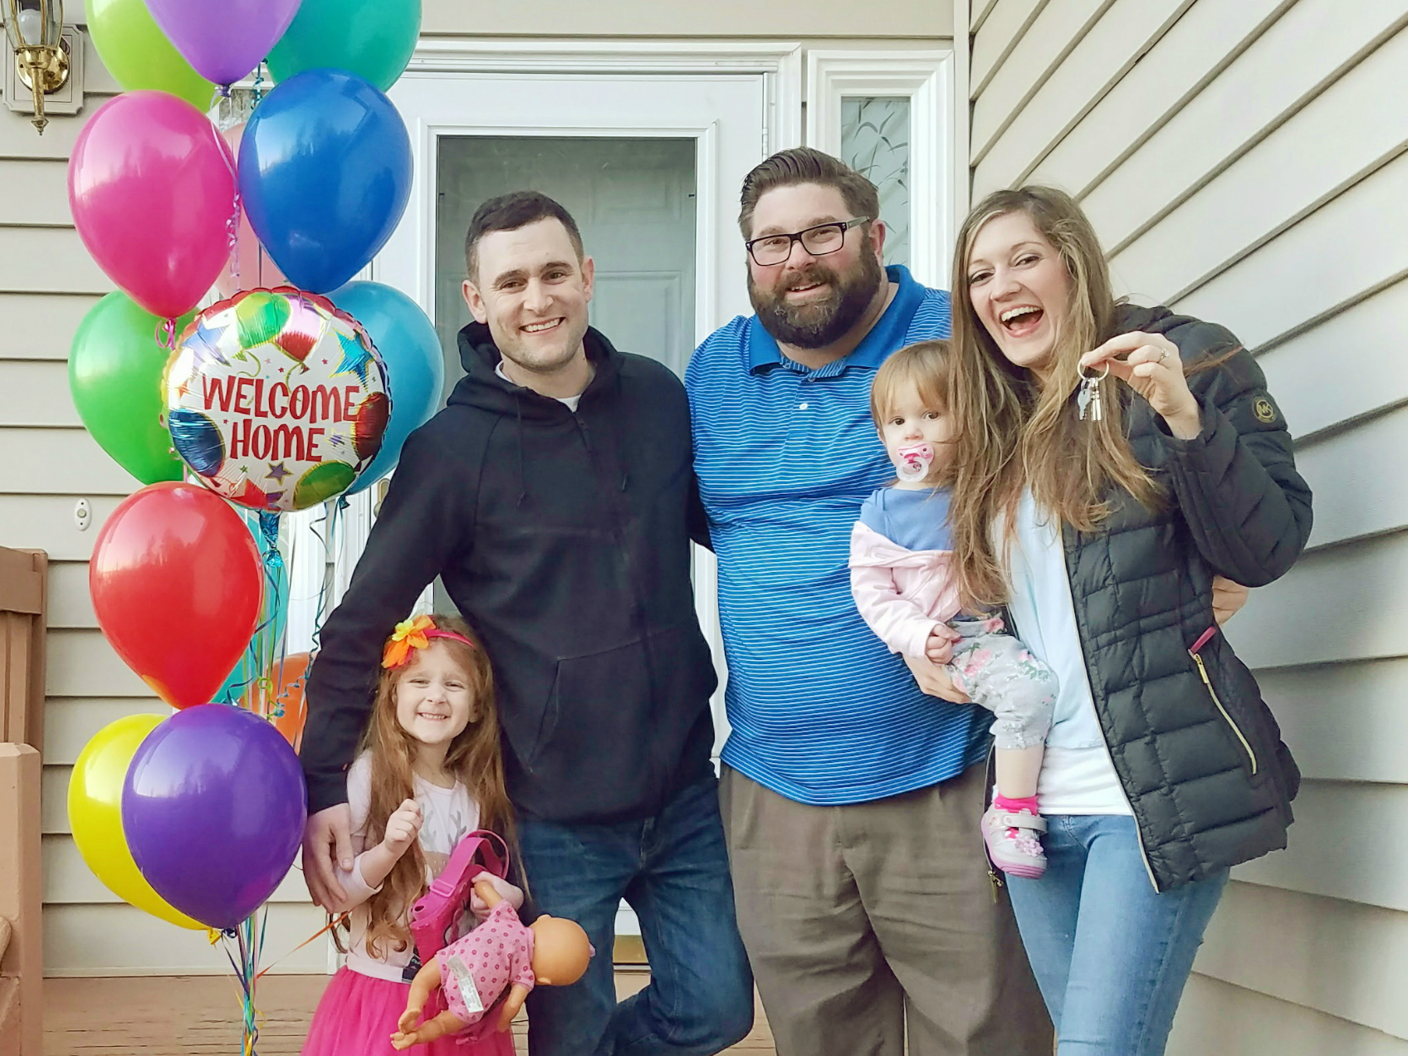
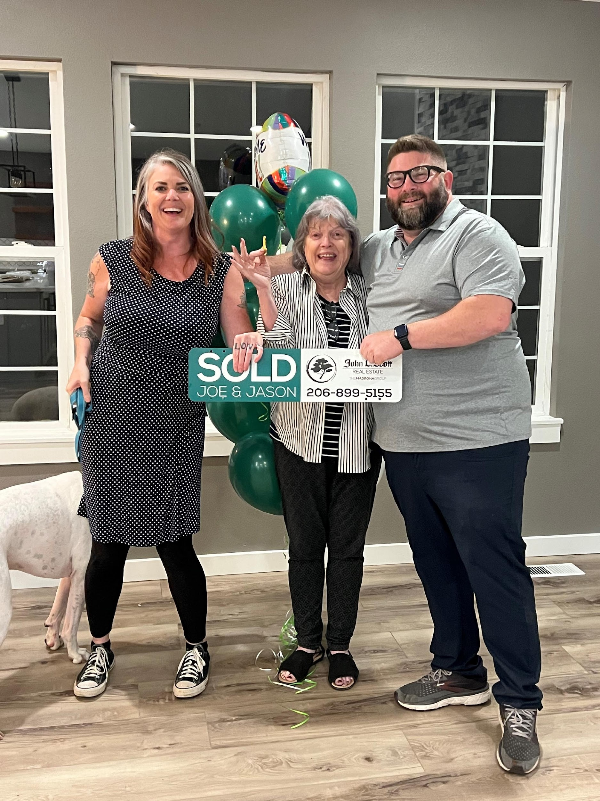

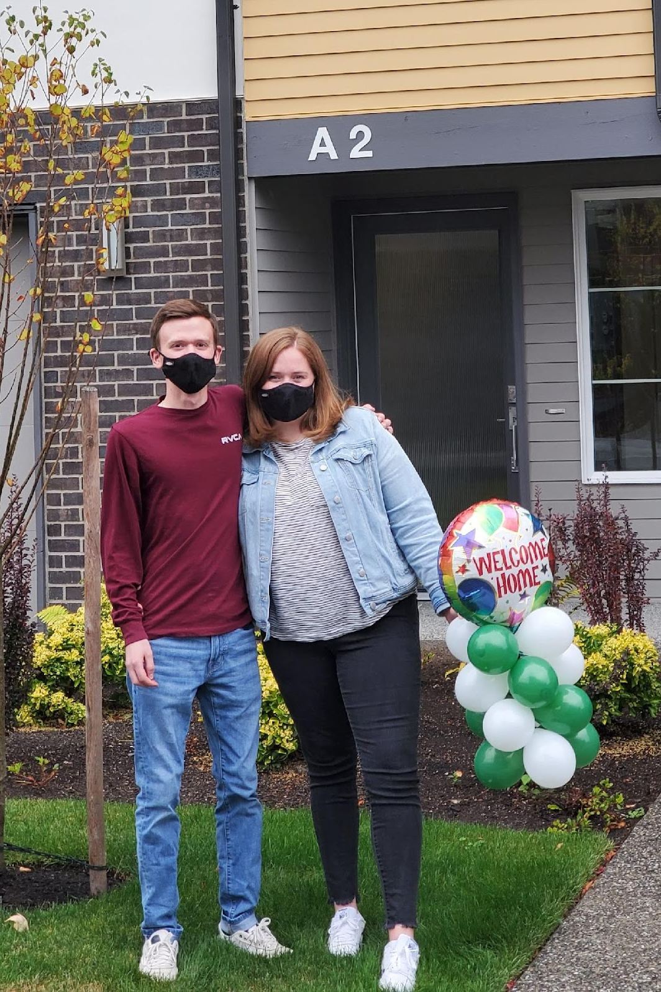
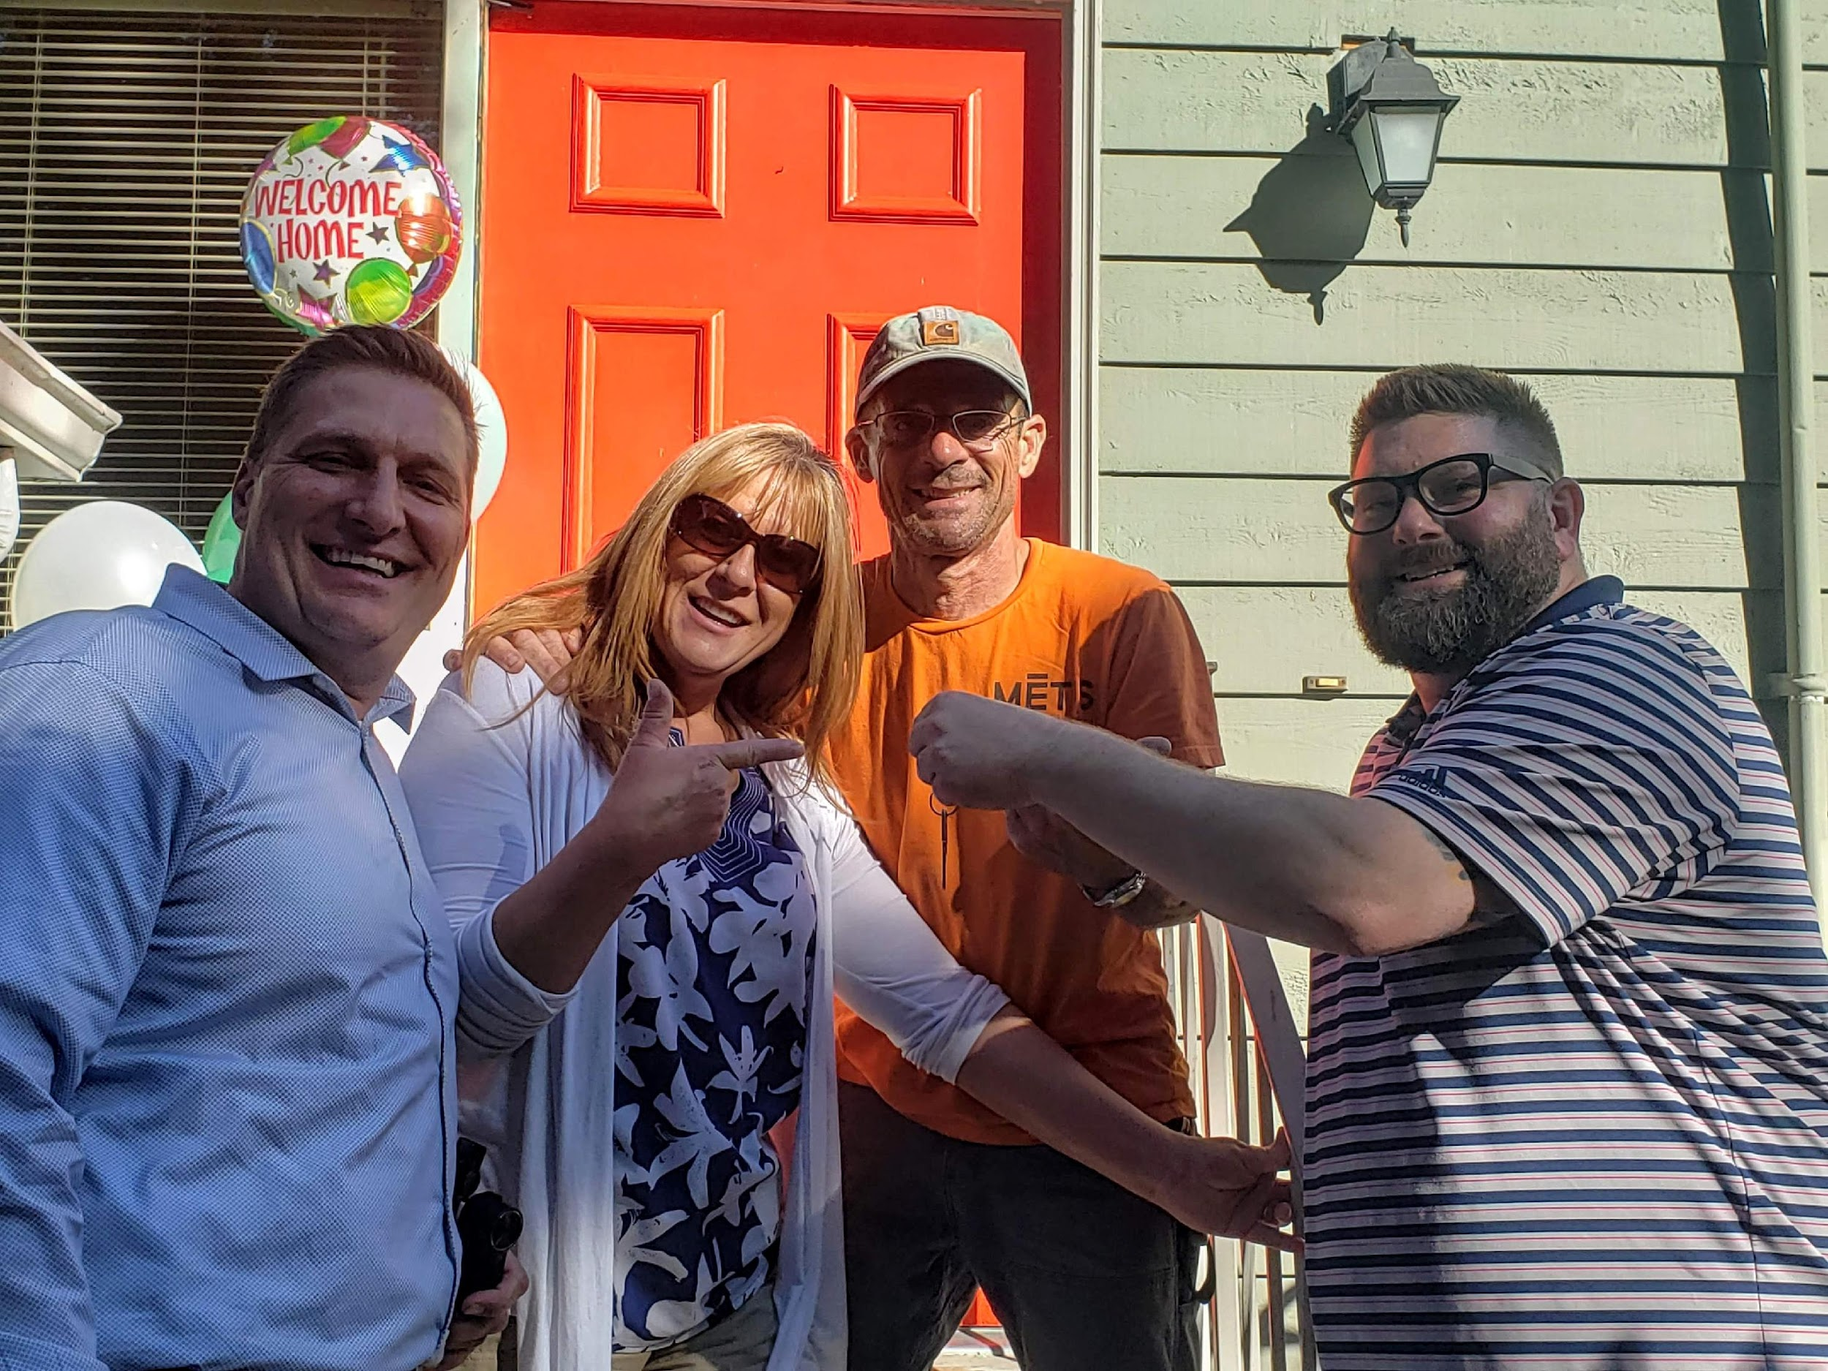
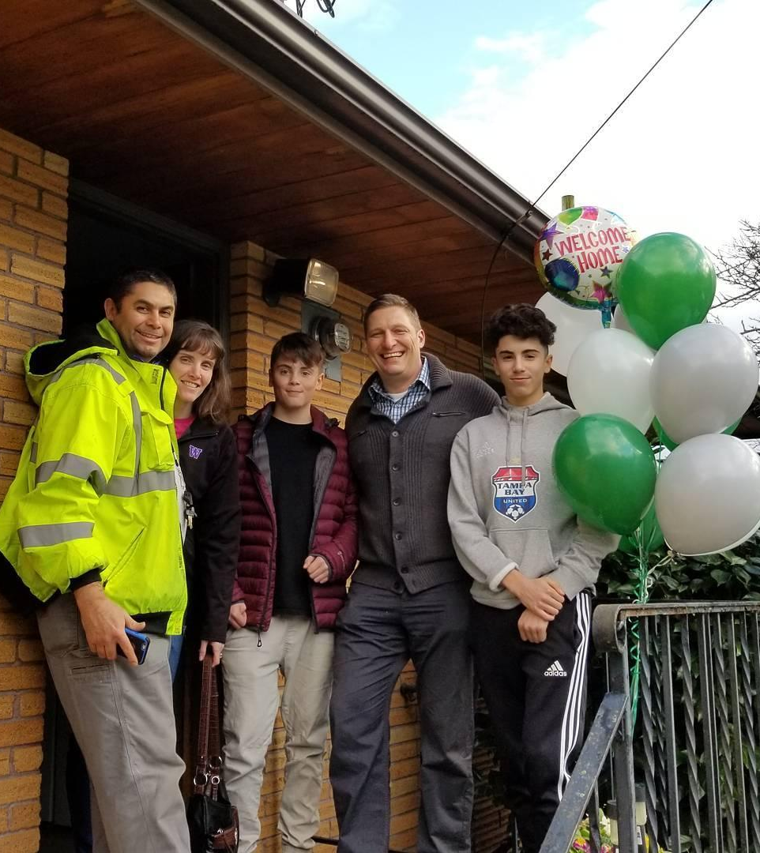
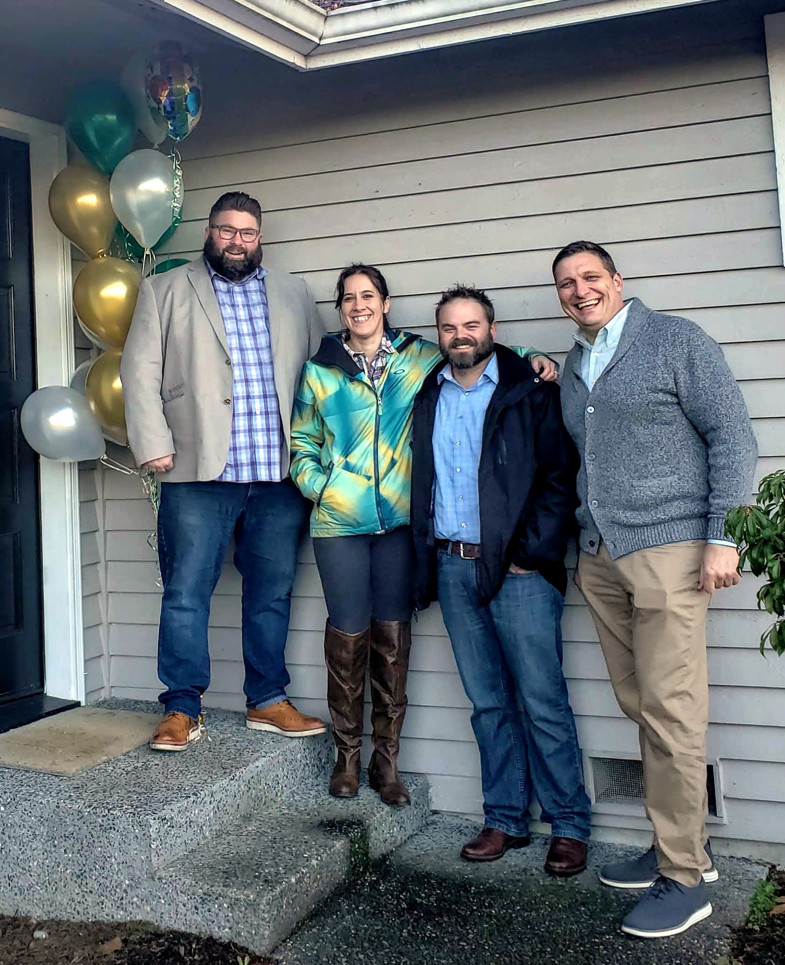

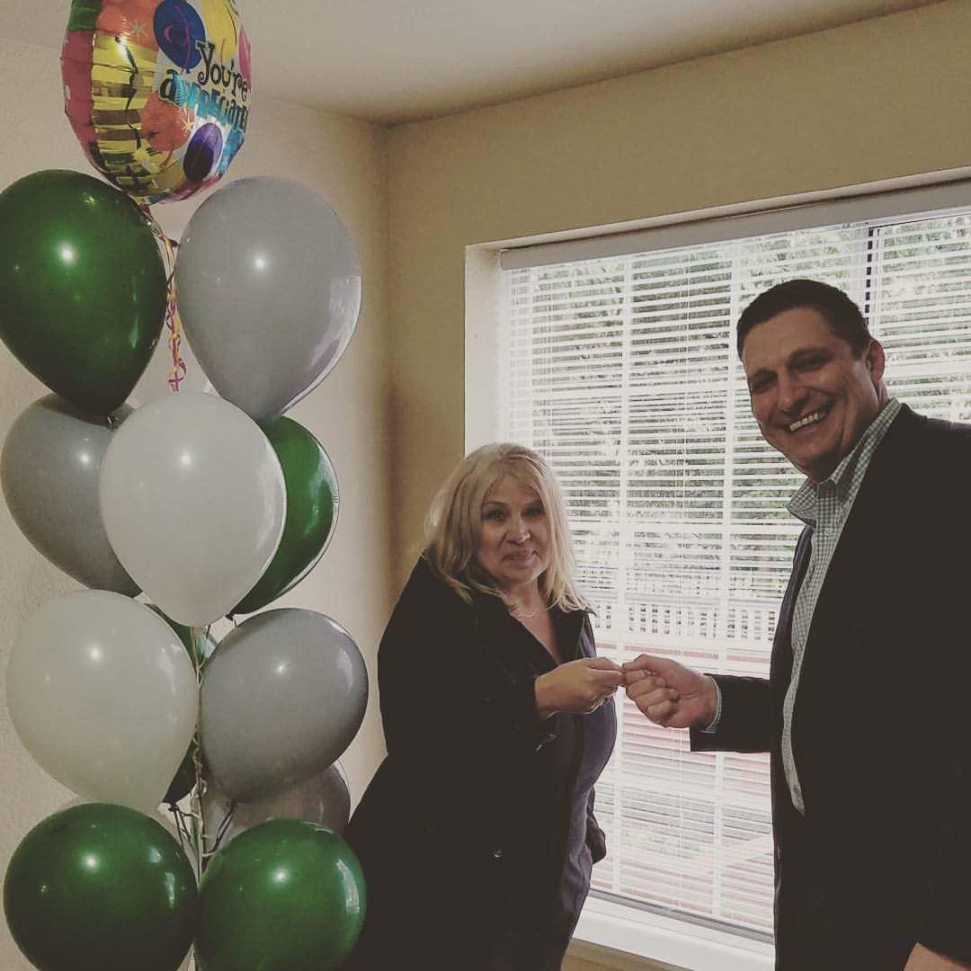

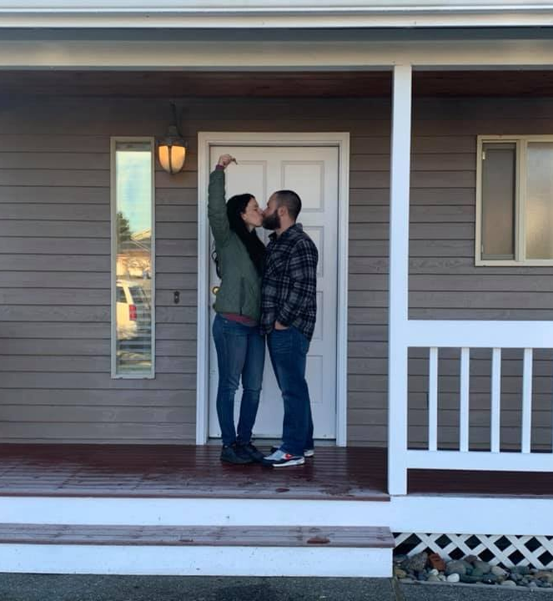
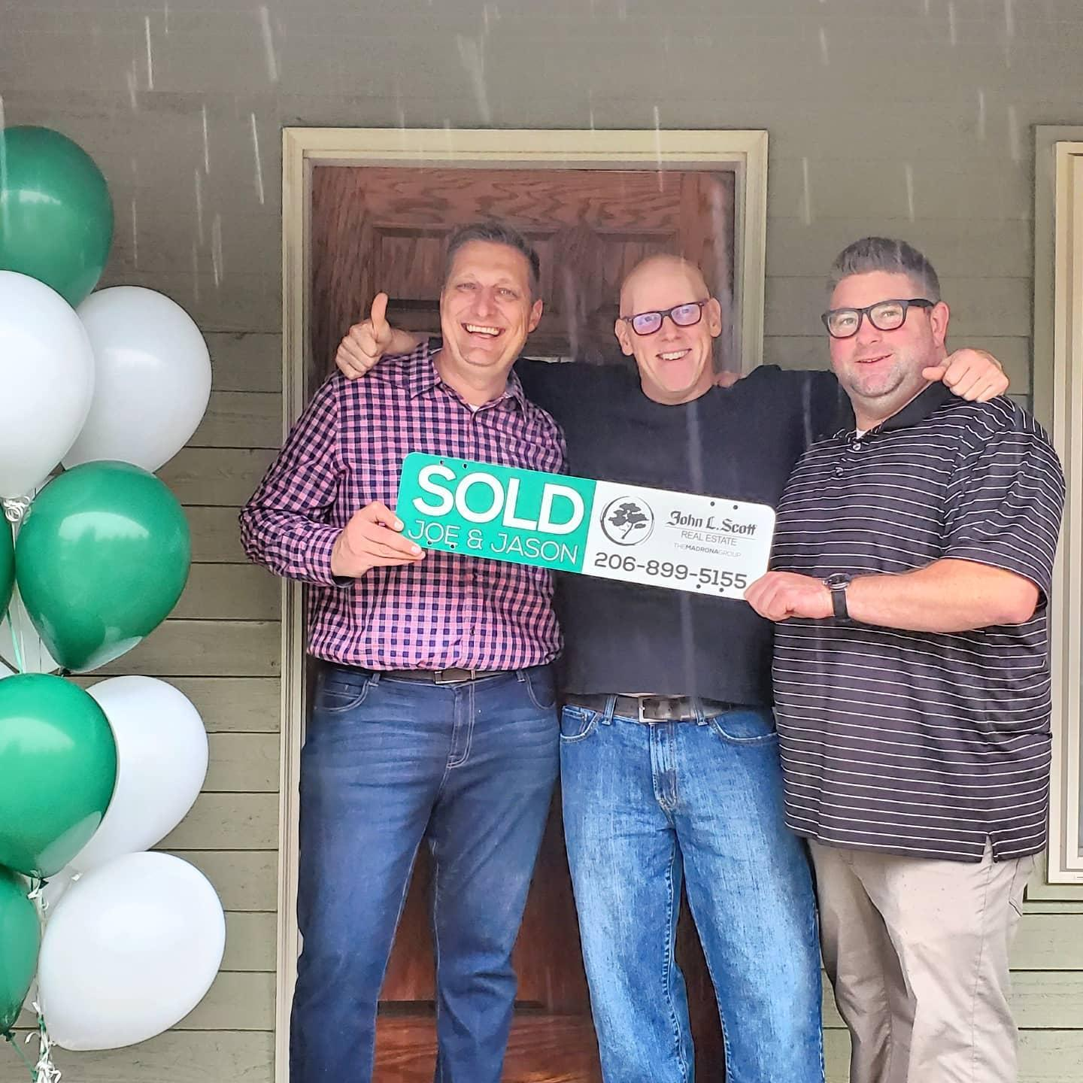
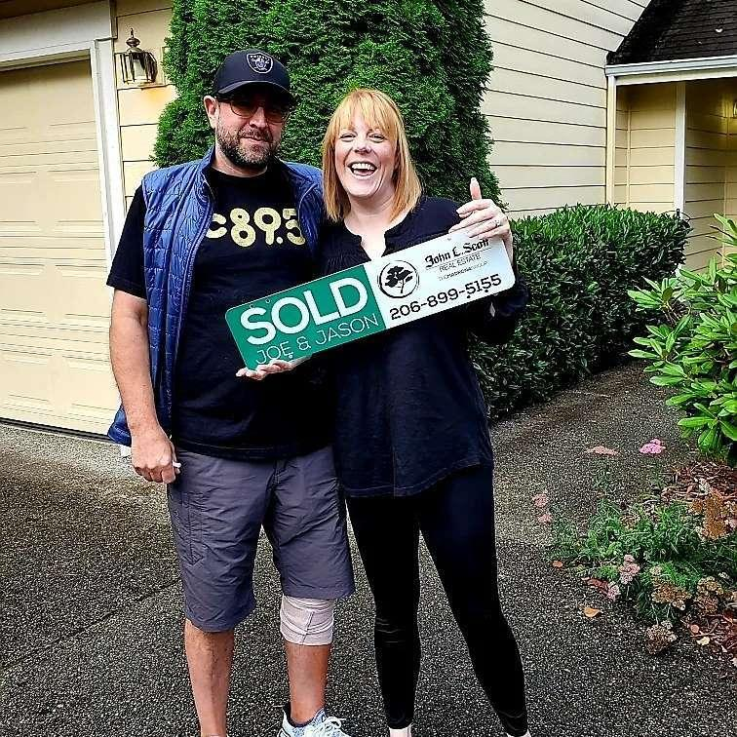
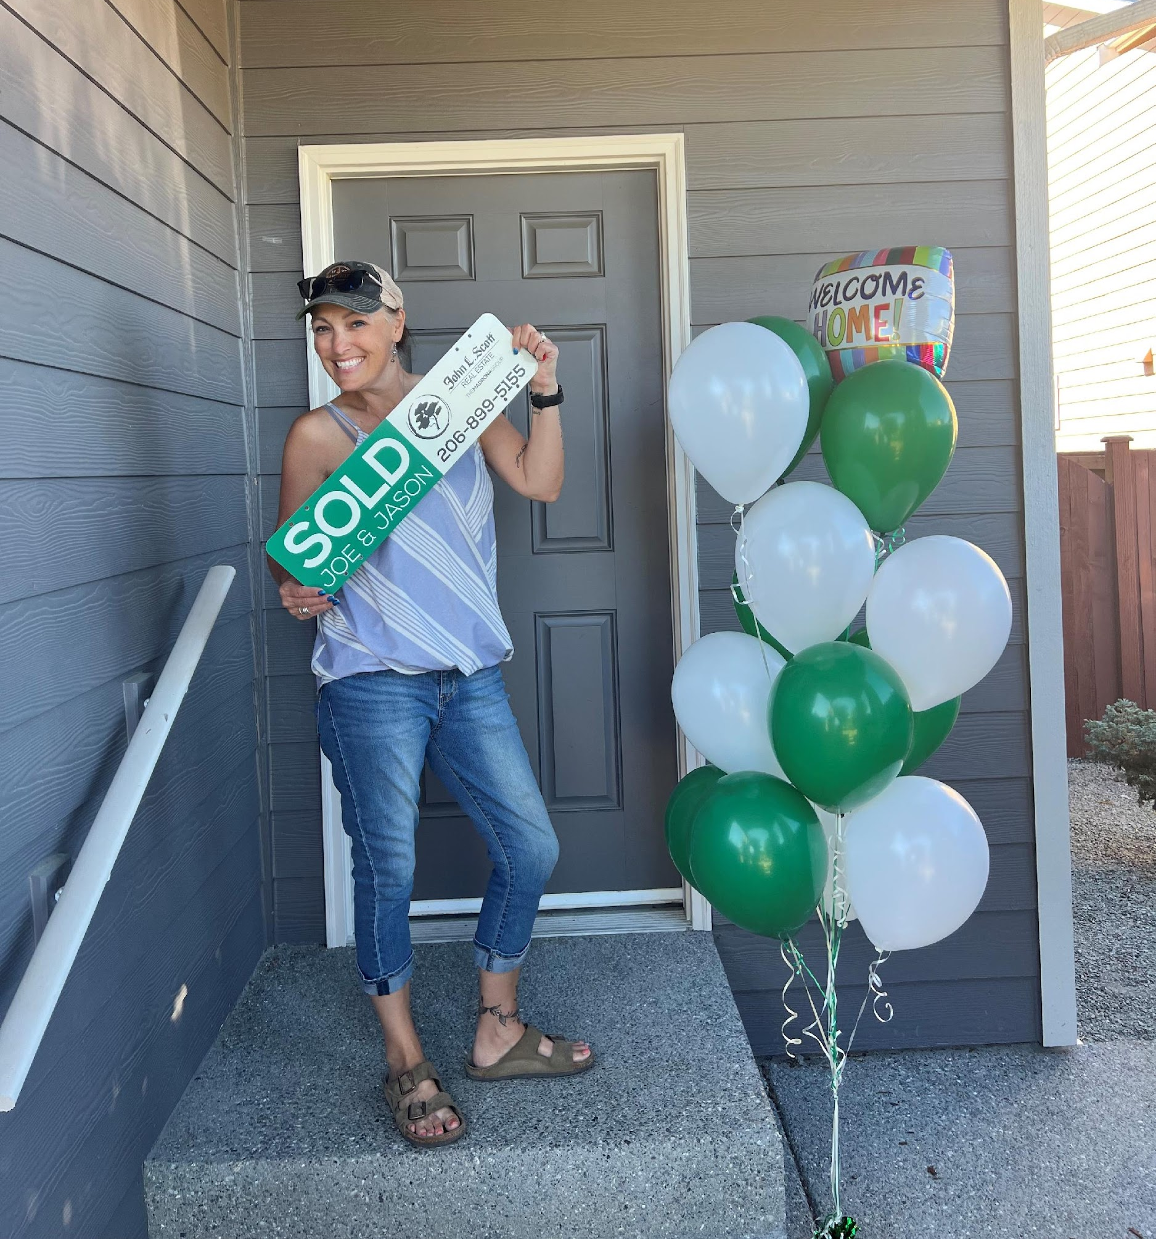

WHAT OUR CLIENTS SAY ABOUT US
“Ashley is an amazing agent! Confident, honest and kind. I know she cares about her clients because I work with her behind the scenes and see how she fights for her clients to make sure they're getting the best deal and to get their transaction closed on time. She communicates with her clients and other agents which is a plus when a lot of agents don't even answer their phone or emails. She's always looking out for her clients' best interest above all else.”
Myda Muckala
Ashley has been a true gift for me trying to navigate the tough and competitive Seattle real market, especially coming from the east coast where the market did not seem as crazy as here. Her knowledge of the market, professionalism and affable personality along with her ethics were what I found to be most impressive. She is also extremely responsive and her enthusiasm to find you the best deal are unparalleled. I found her to be extremely hardworking and dedicated to her job to provide the best experience to the buyer especially in a wild market as this one. I would highly recommend Ashley based on my experience of having bought a really sweet house of my choice and liking within a short time, all thanks to Ashley's persistence, hard work and firm yet gentle negotiating skills. She is also super fast in.providimg comps.and other relevant information about potential properties. What is even more commendable is Ashley's diligence to follow up even after the process is complete. Also her team member Joshua deserves special.mention for his enthusiasm and cheerful disposition and supporting the process when needed. I wish Ashley and her team the very best in their work in a tough market as this one, not to mention a tougher clientele as well🙂
Jay Prasad
Find Our Raving Fans on Zillow, Yelp, Google, Facebook, Redfin and Youtube

Slide 6
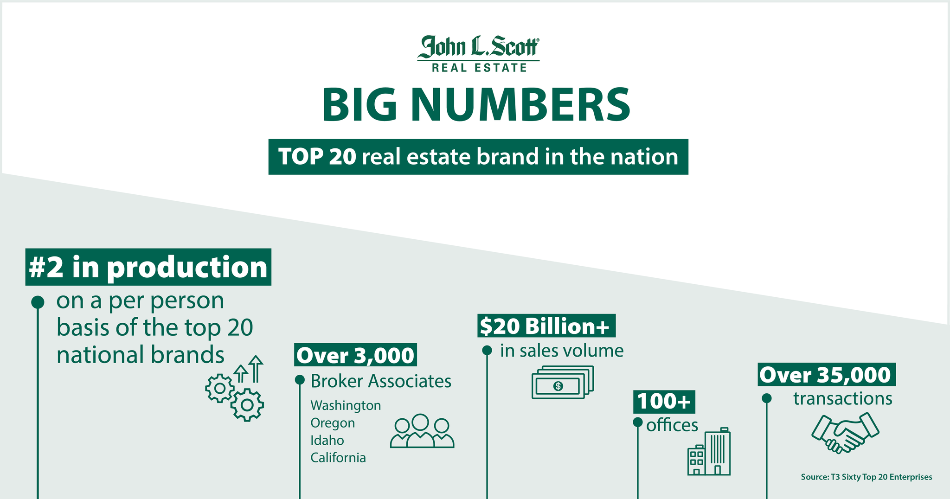
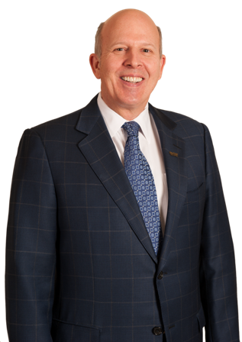

JOHN L. SCOTT REAL ESTATE
At John L. Scott Real Estate, our business is transactional excellence, but our higher purpose is
“Living Life as a Contribution®.”
J. Lennox Scott, Chairman and CEO
29th Most Influential Person in Real estate

Slide 7
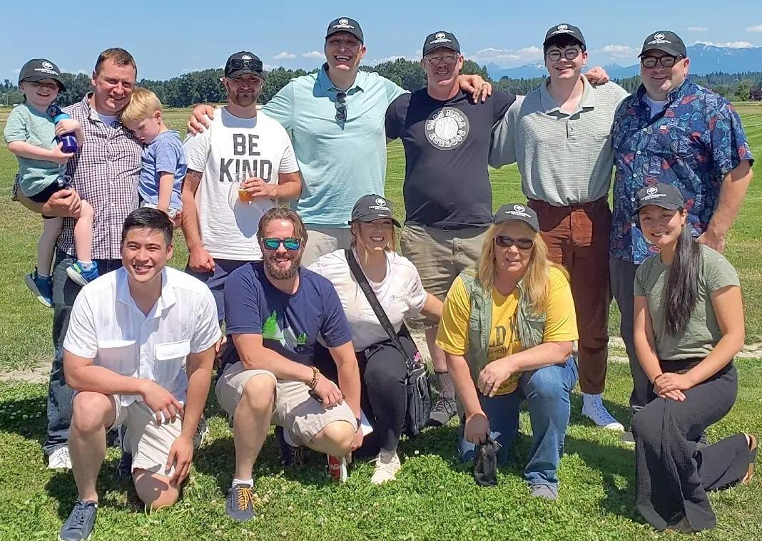



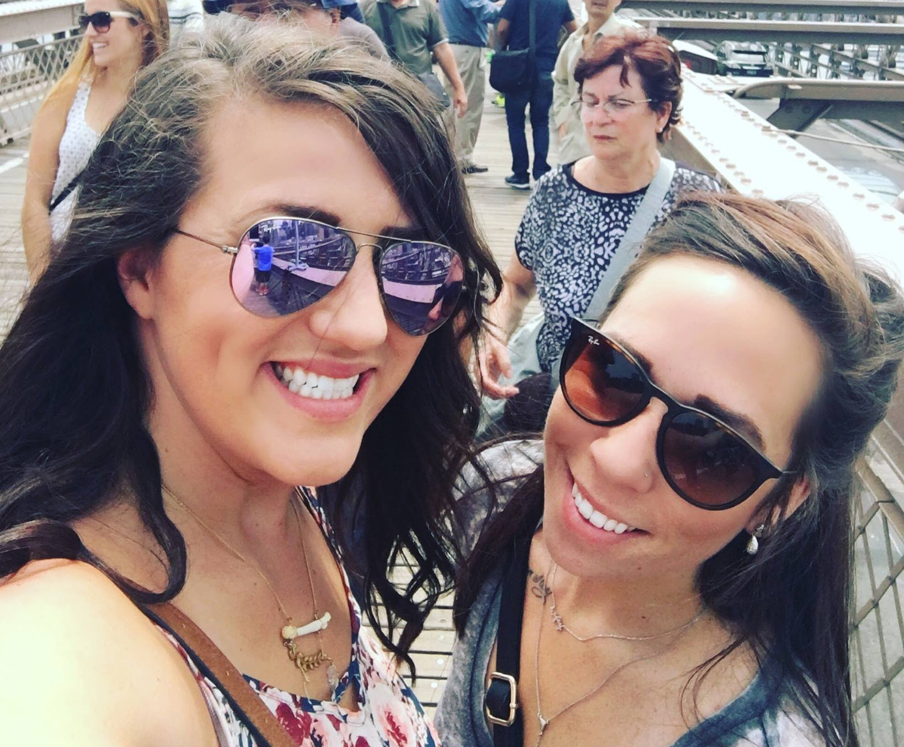



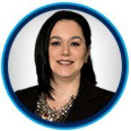






THE POWER OF A TEAM
TEAM TMG
CHRIS FIAMENGO
TEAM LEADER
RAIYA W
TEAM ASSISTANT
MYDA MUCKALA
TRANSACTION COORDINATOR
MEGAN & JESSICA
STAGERS
ALEXA MORROW
PRODUCTION ASSOCIATE
DAVE BRYCE
SENIOR LOAN OFFICER
LEAH NICHOLSON
LOAN OFFICER ASSISTANT
DHARMA DUNN
ESCROW CLOSER
BRANDON TEMPLE
PHOTOGRAPHER
MARGARITO BARRERA
GENERAL CONTRACTOR
All Working Together To Make Sure You Meet Your Goals

Slide 8



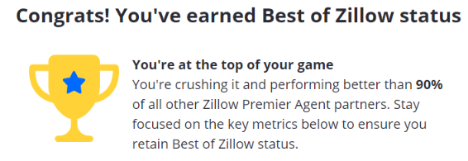

THE RIGHT REPRESENTATION
MLS MEDIAN DAYS ON MARKET | THE MADRONA GROUP MEDIAN DAYS ON MARKET
7 | 5
MLS MEDIAN % OF PRICE | THE MADRONA GROUP MEDIAN % OF PRICE
100% | 102%
The Madrona Group Exceeds Expectations

Slide 9


UNIQUE VALUE PROPOSITION
WE SAVE YOU TIME AND MONEY
My unique MARKETING SKILLS will put your home in front of more possible buyers that will help you sell faster.
We Take Selling Your Home Very Seriously.
We Only Have One Shot To List Your Home and Generate the BUZZ to Attract Multiple Ready, Willing and Able Buyers to Sell Your Home Quickly and for the Highest Possible Price.
My unique NEGOTIATING SKILLS will ensure that your homes sells for the most amount of money.

Slide 10
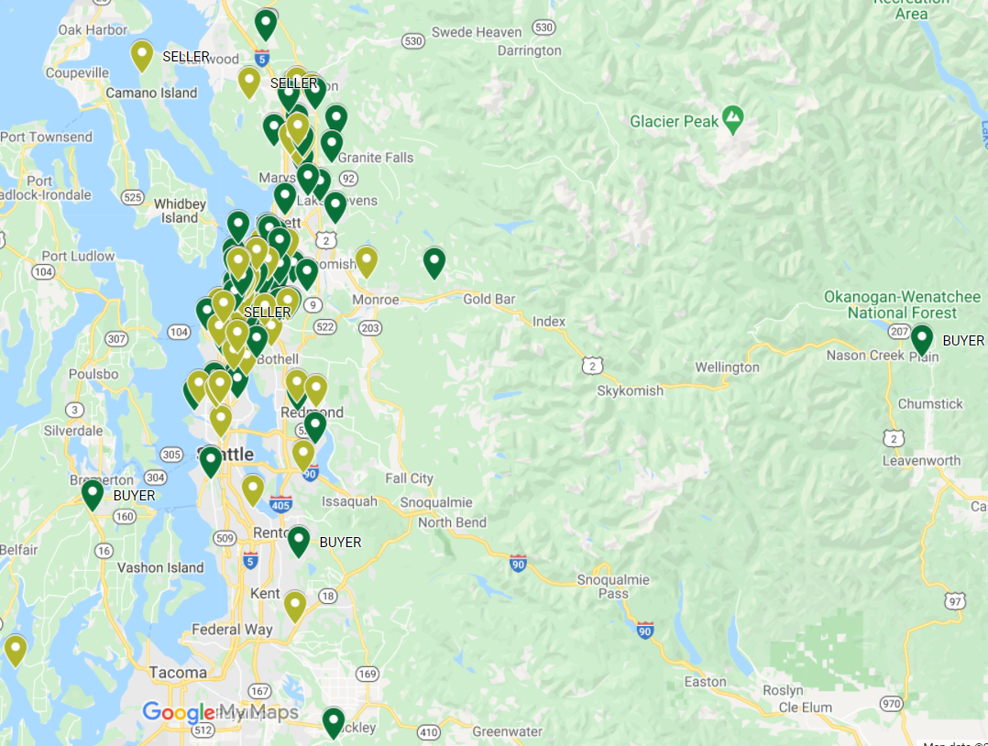

MAP OF SOLD HOMES
CLICK TO VIEW INTERACTIVE MAP
We Sell From Arlington to Heron Island From Port Angeles to Plaine and Everywhere In Between

Slide 11






3 WAYS TO SELL YOUR HOME
CASH BUYER
OPEN MARKET
MARKET READY DAY 1
Amazing digital marketing plan gets your home Maximum Exposure both online and offline. The traditional method of home sales.
Home is Move-In-Ready
High Net Return
No Expenses
No Program Needed
John L. Scott exclusive program to find cash buyers for your home.
Faster
Sell As Is
10-20% Less Profit
No Fee
John L. Scott exclusive program to access equity in home for updates.
No Out Of Pocket $
Highest Net Return
Takes Some Time
No Fee
You Have Choices When It Comes To Selling Your Home

Slide 12

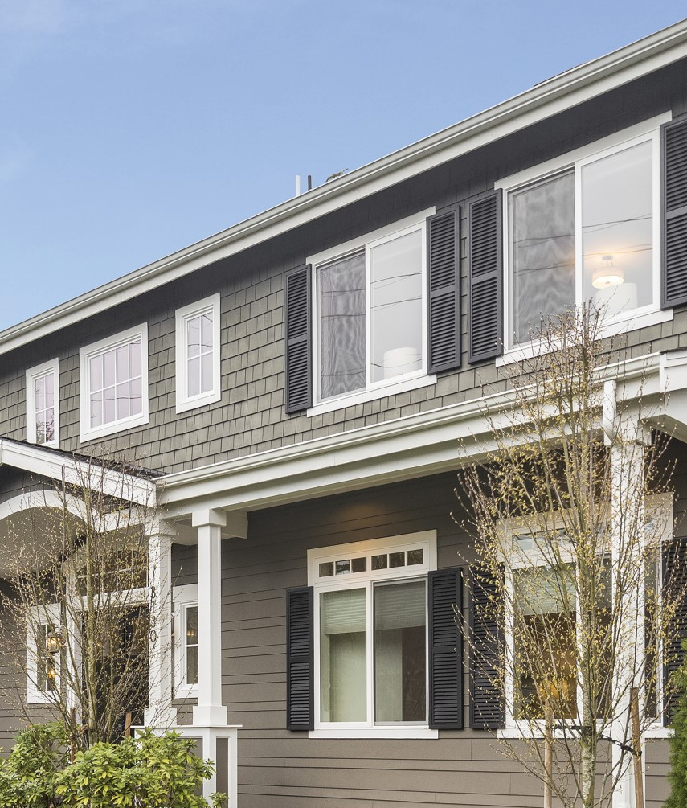
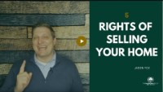

GET THESE FIVE THINGS RIGHT
To Sell Your Home Fast And For The Most Profit

Slide 13
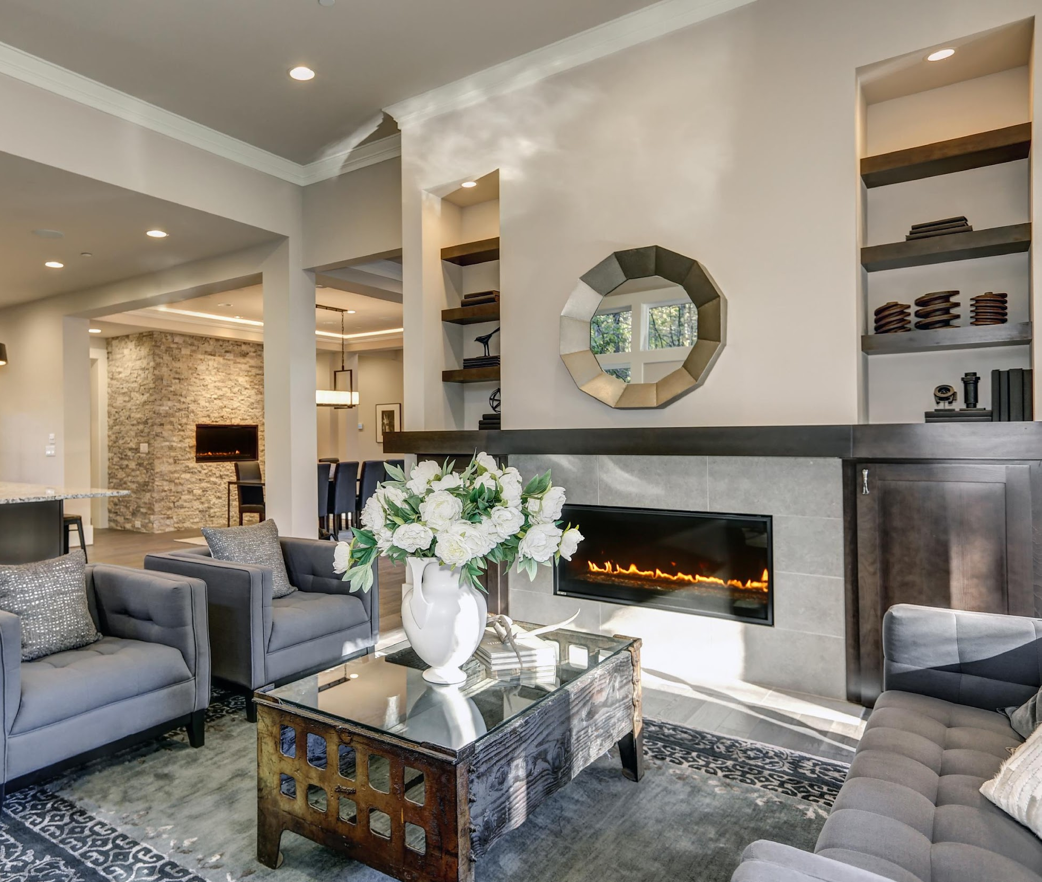
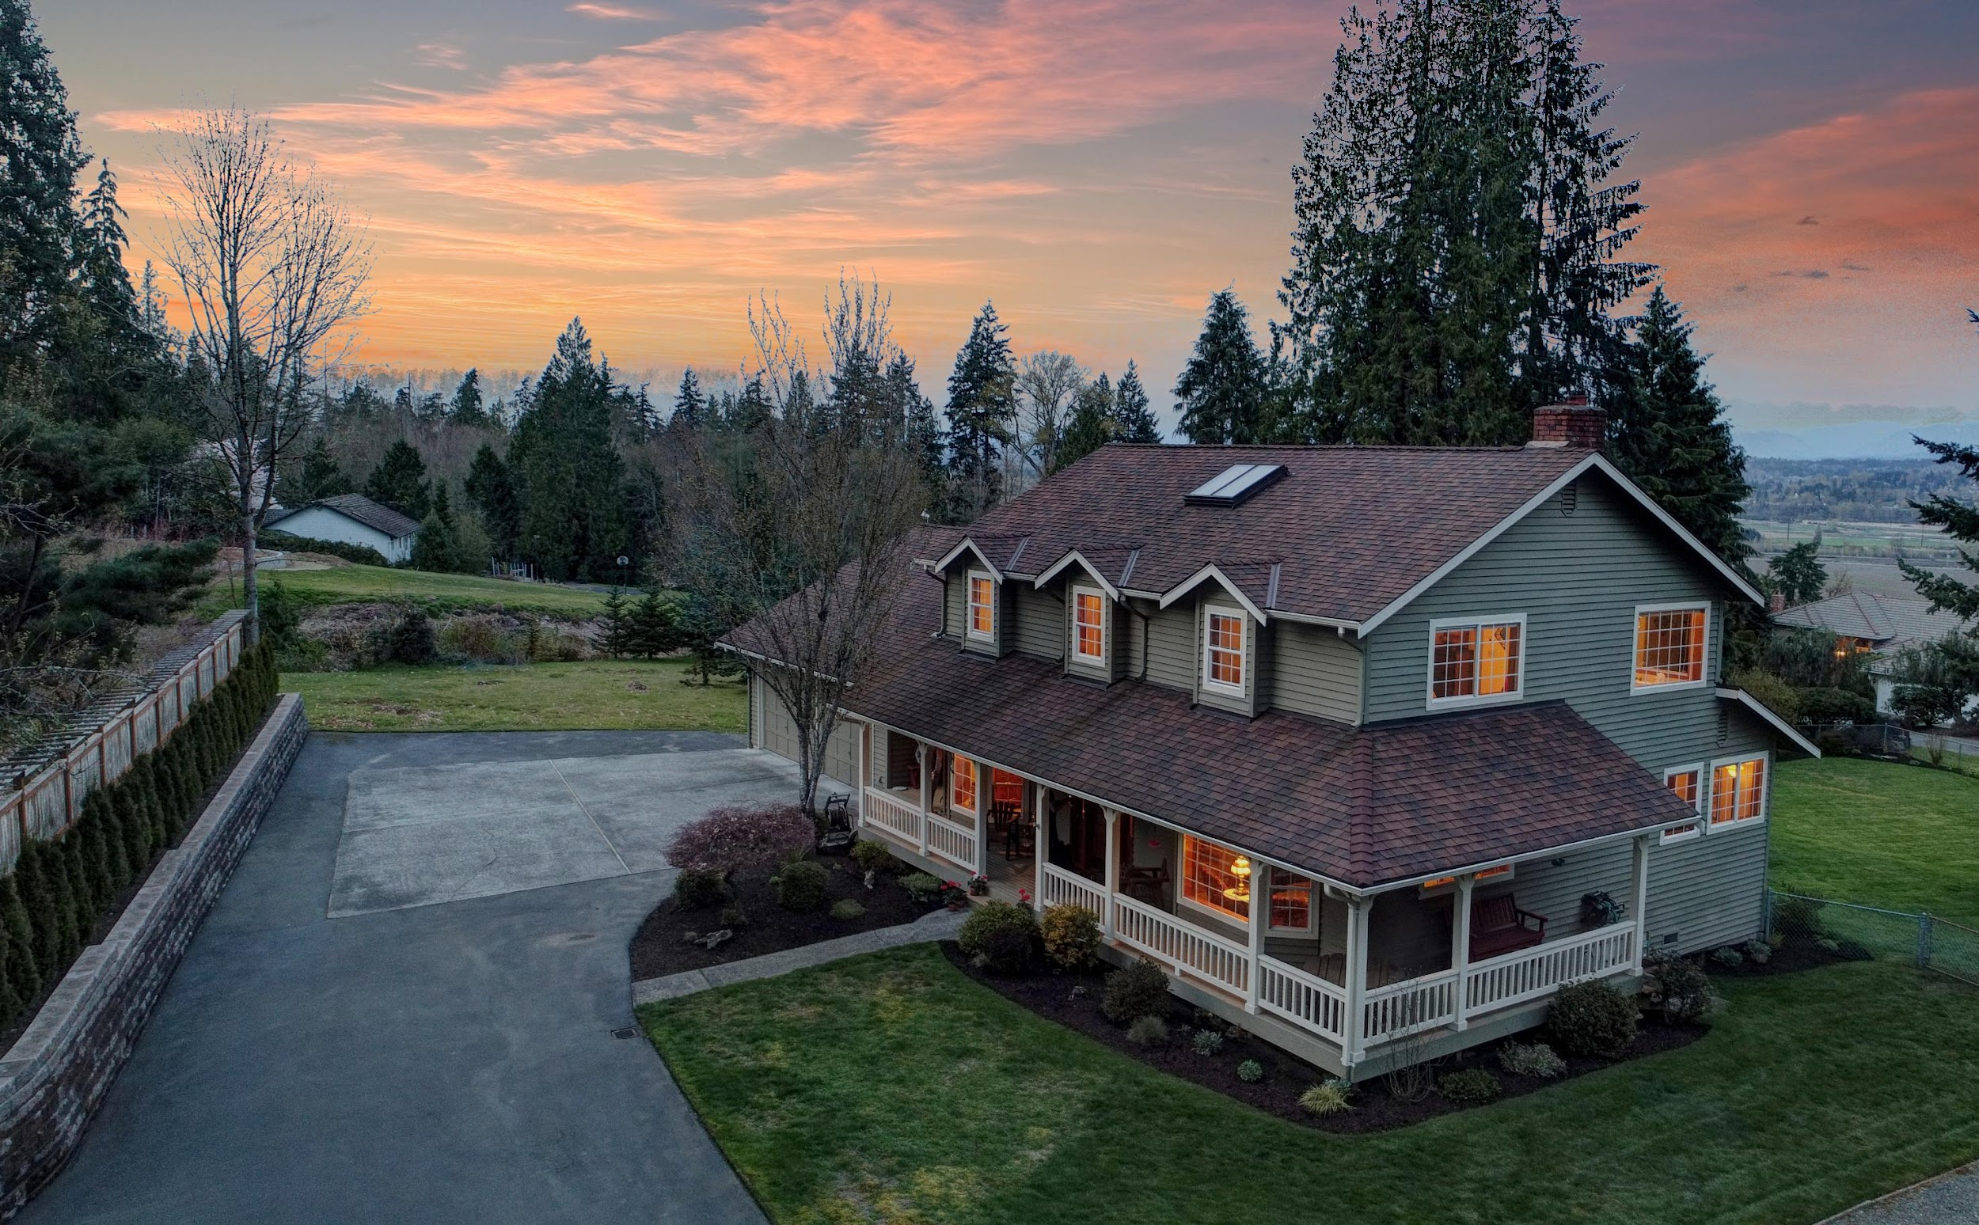
PRESENTATION
HOUSE RIGHT
YARD RIGHT
Get Your House Right by Cleaning, De-Cluttering and Staging
Get Your Yard Right by Focusing on Curb Appeal

Slide 14
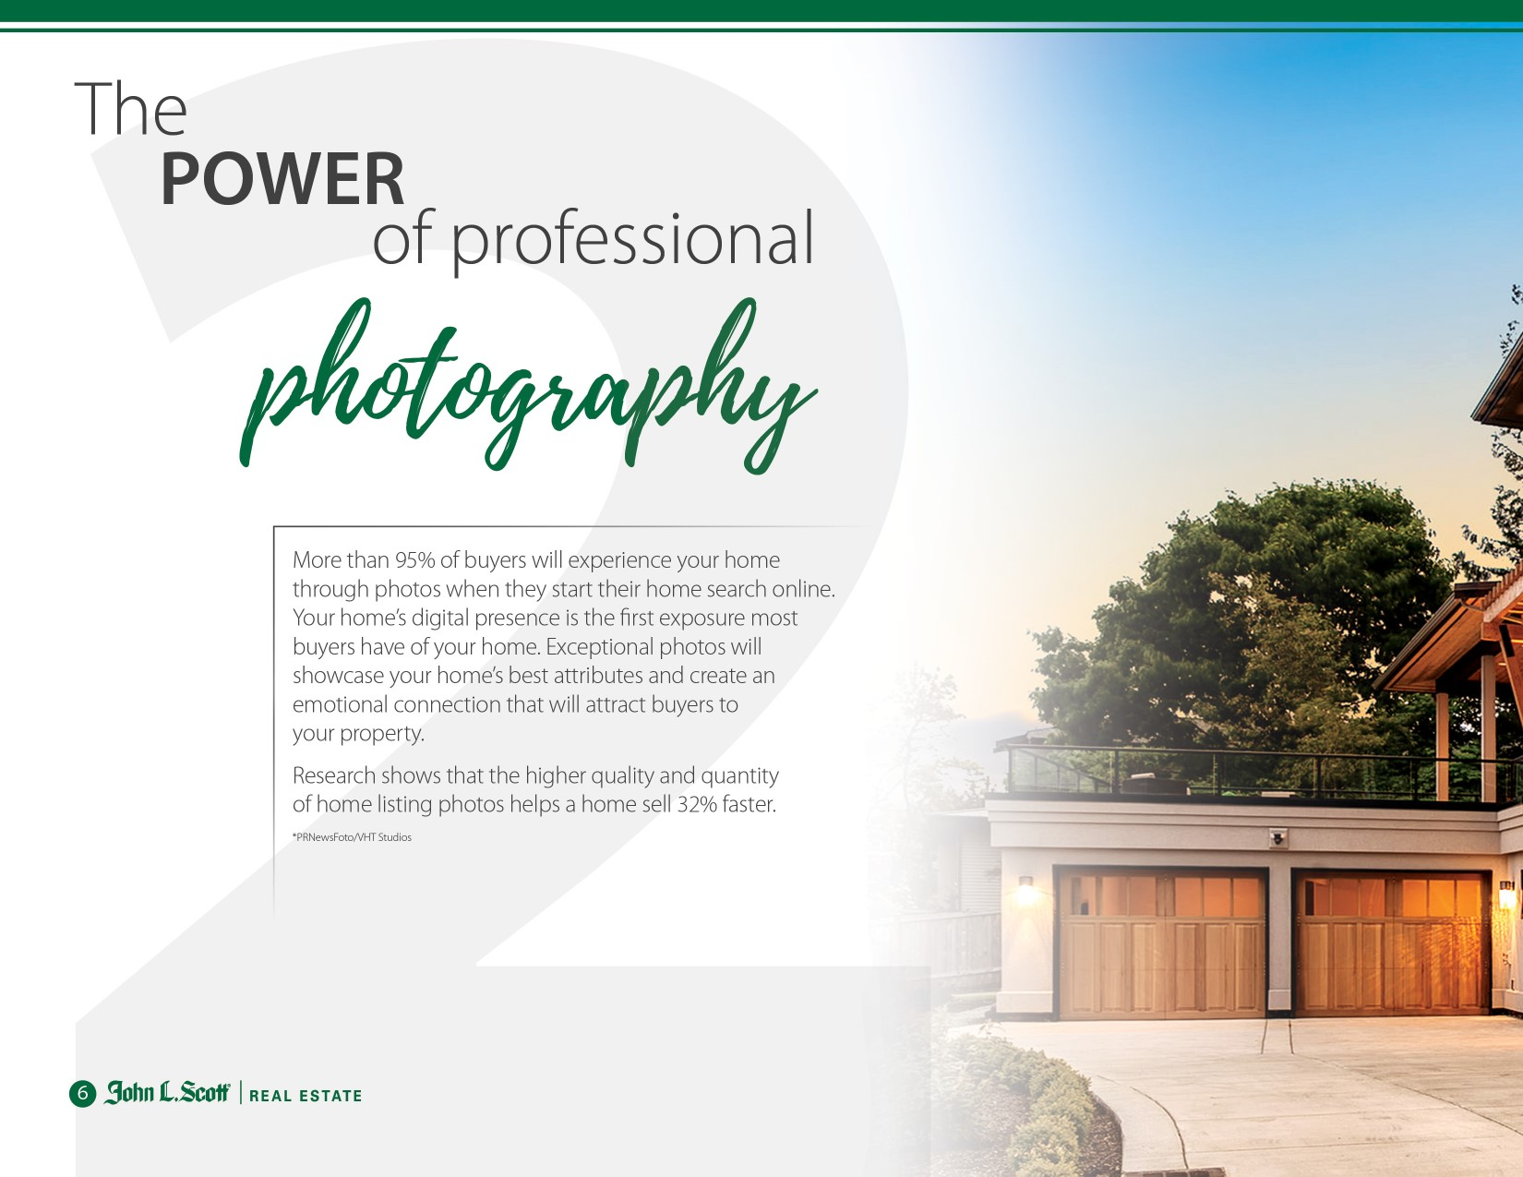
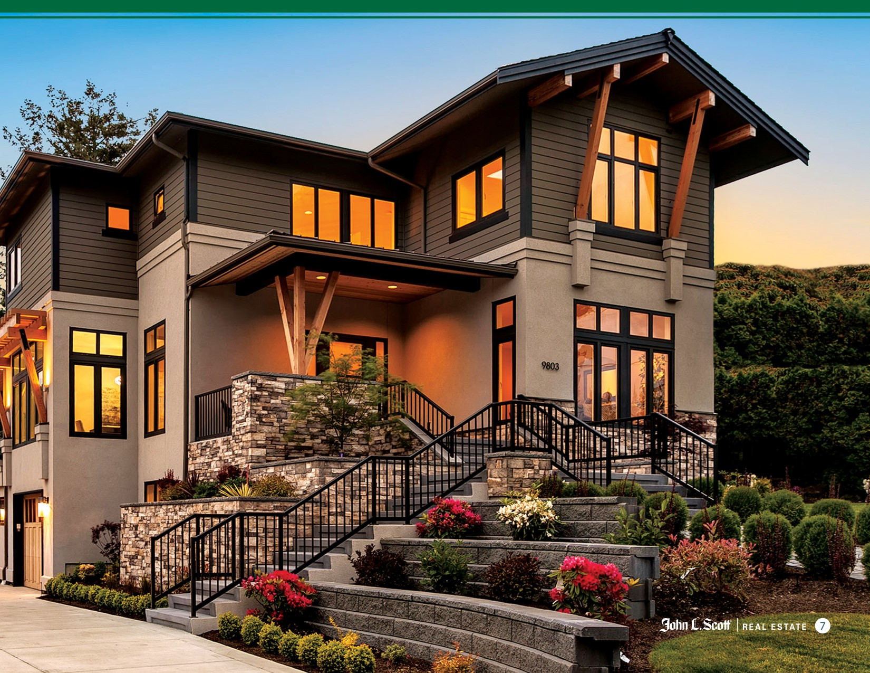


AWARD WINNING PHOTO SHOOT
Our Photographer Has Been Featured On Multiple Magazine Covers

Slide 15
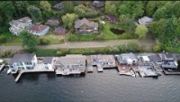
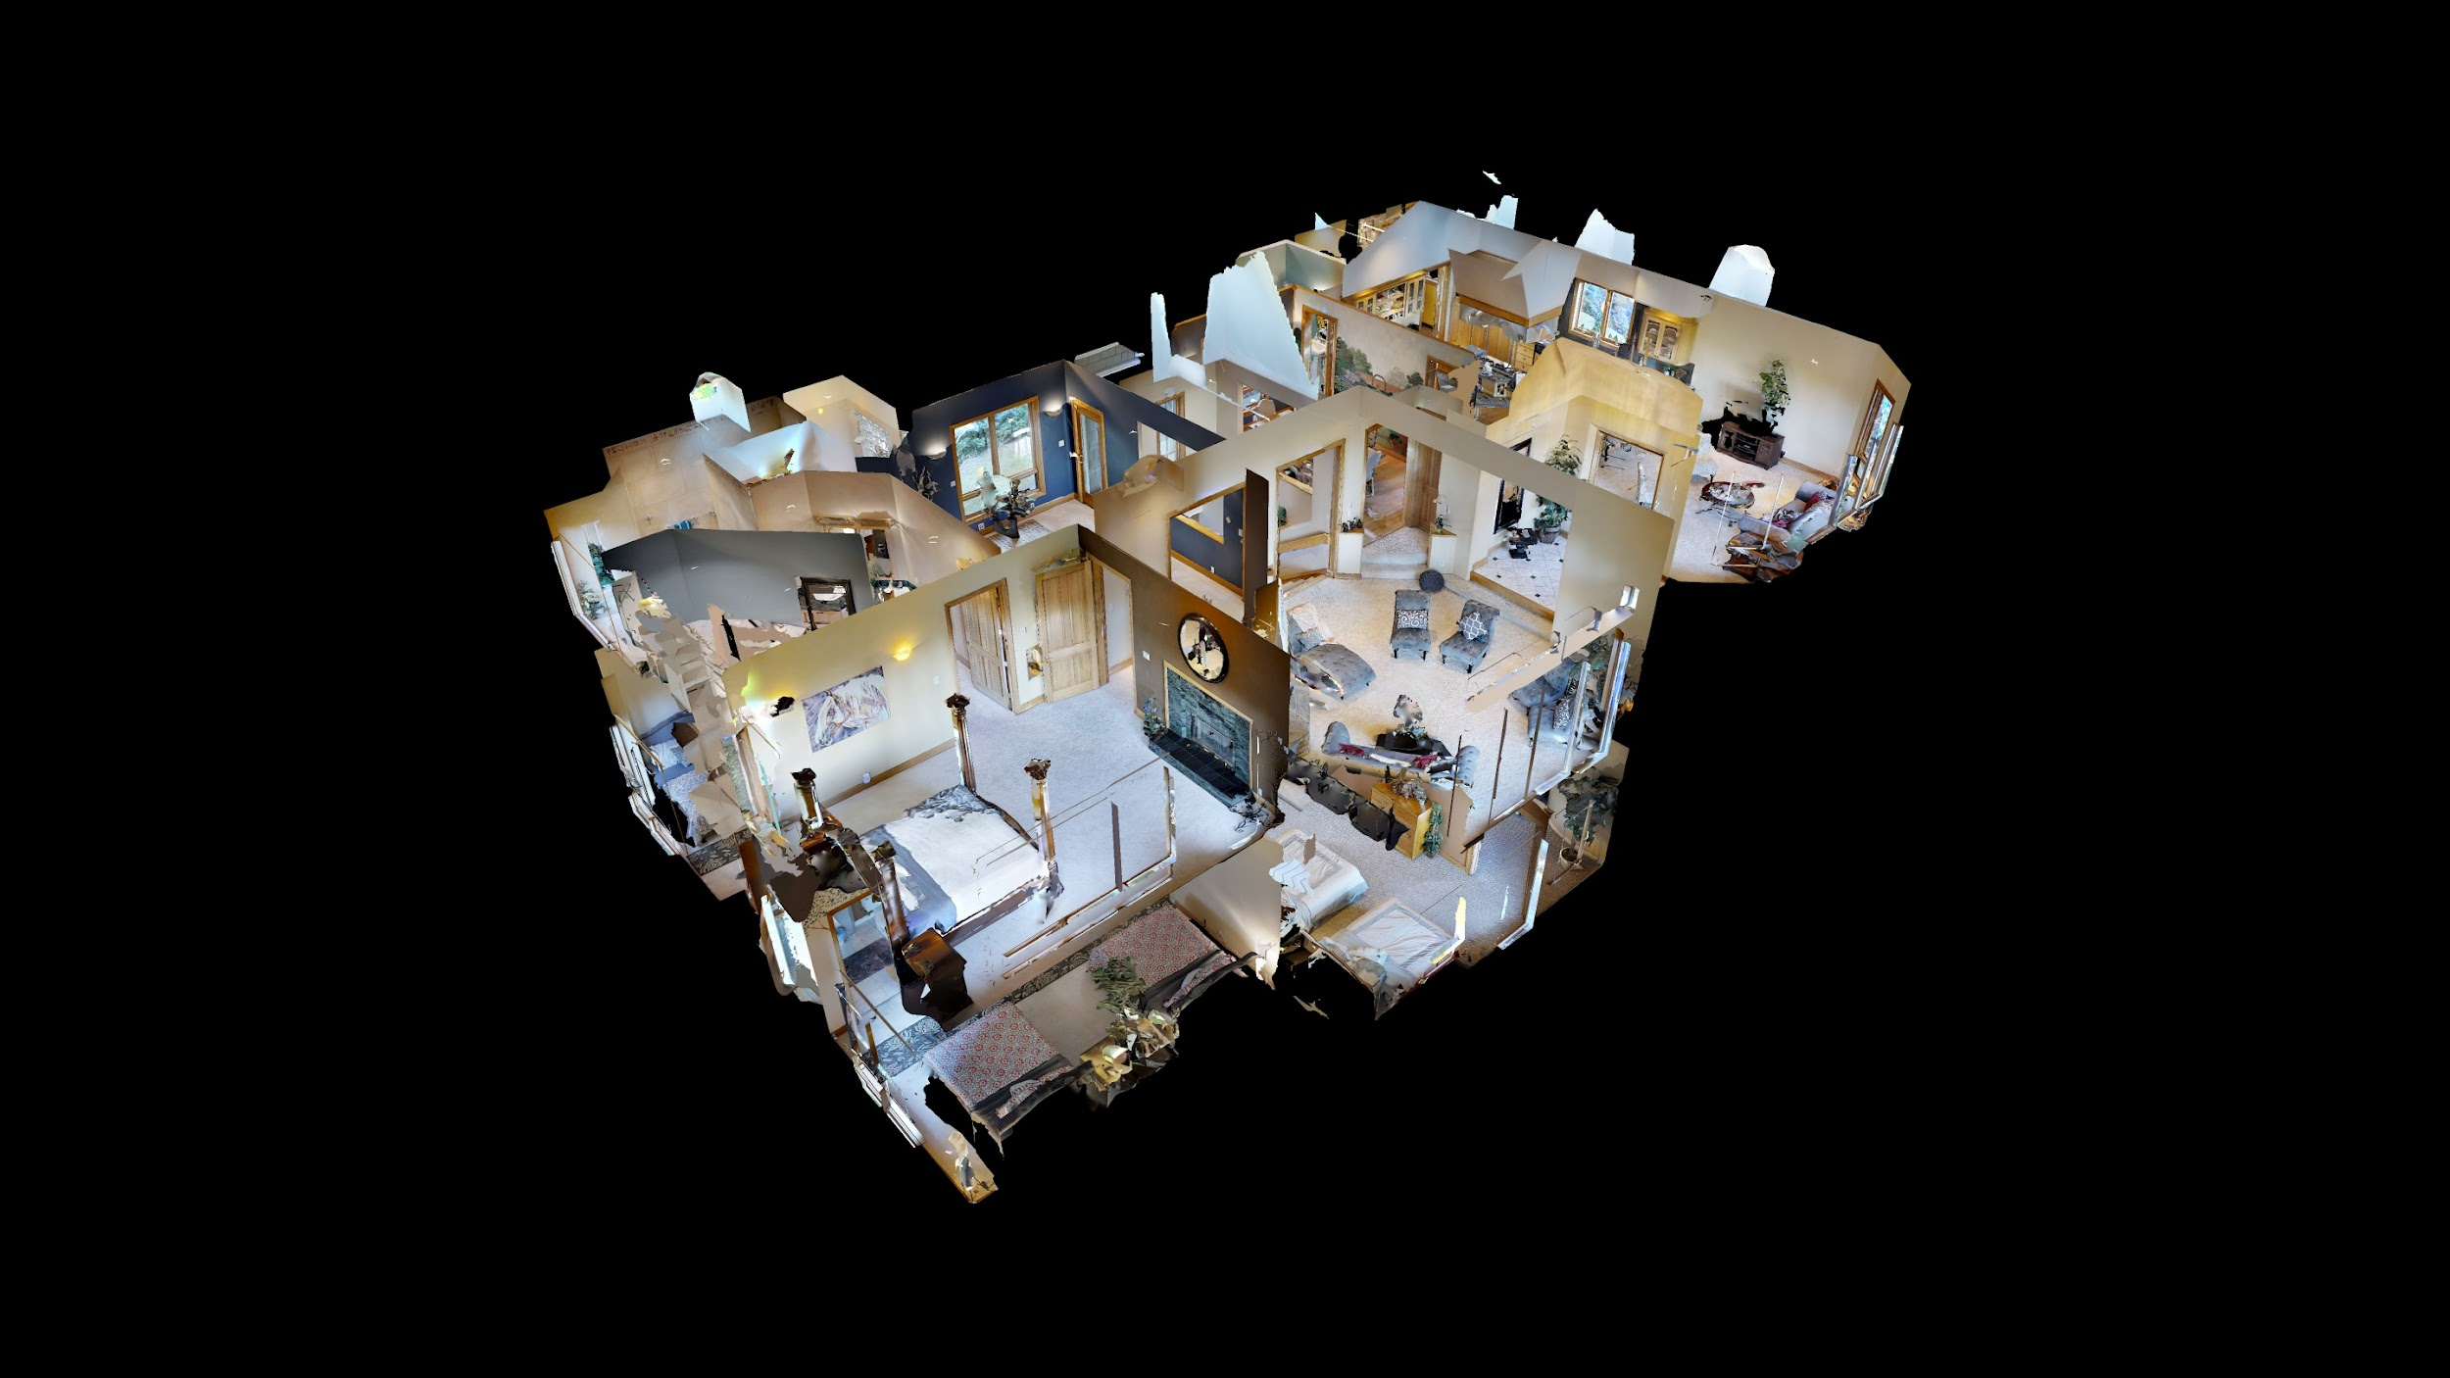
DRONE VIDEO AND 3-D TOURS

Slide 16

PROMOTION
Driving the Highest Number of Ready, Willing and Able Buyers to The Listing in order to create a Frenzy Around Your Home

Slide 17
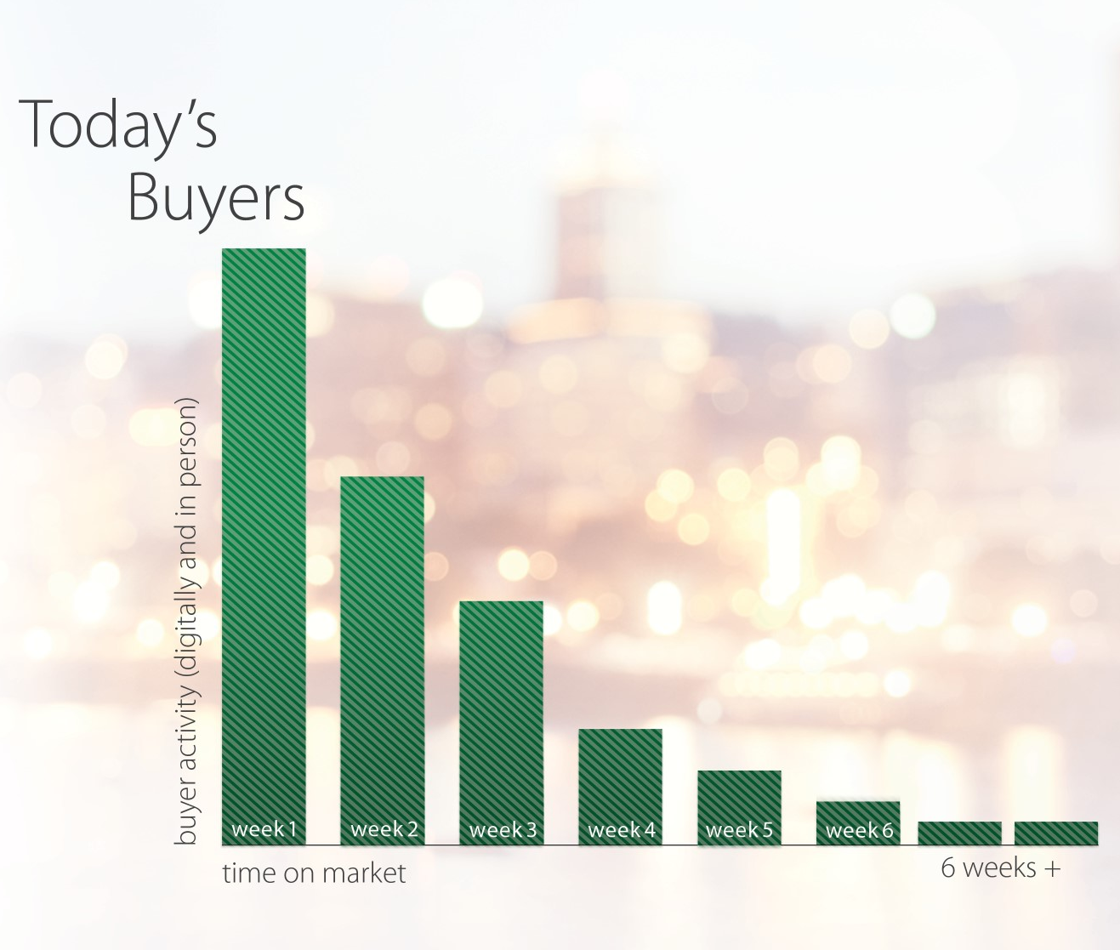
BACKLOG
OF BUYERS
The Buyer Activity is the Highest in the First Week Your Home is on the Market

Slide 18
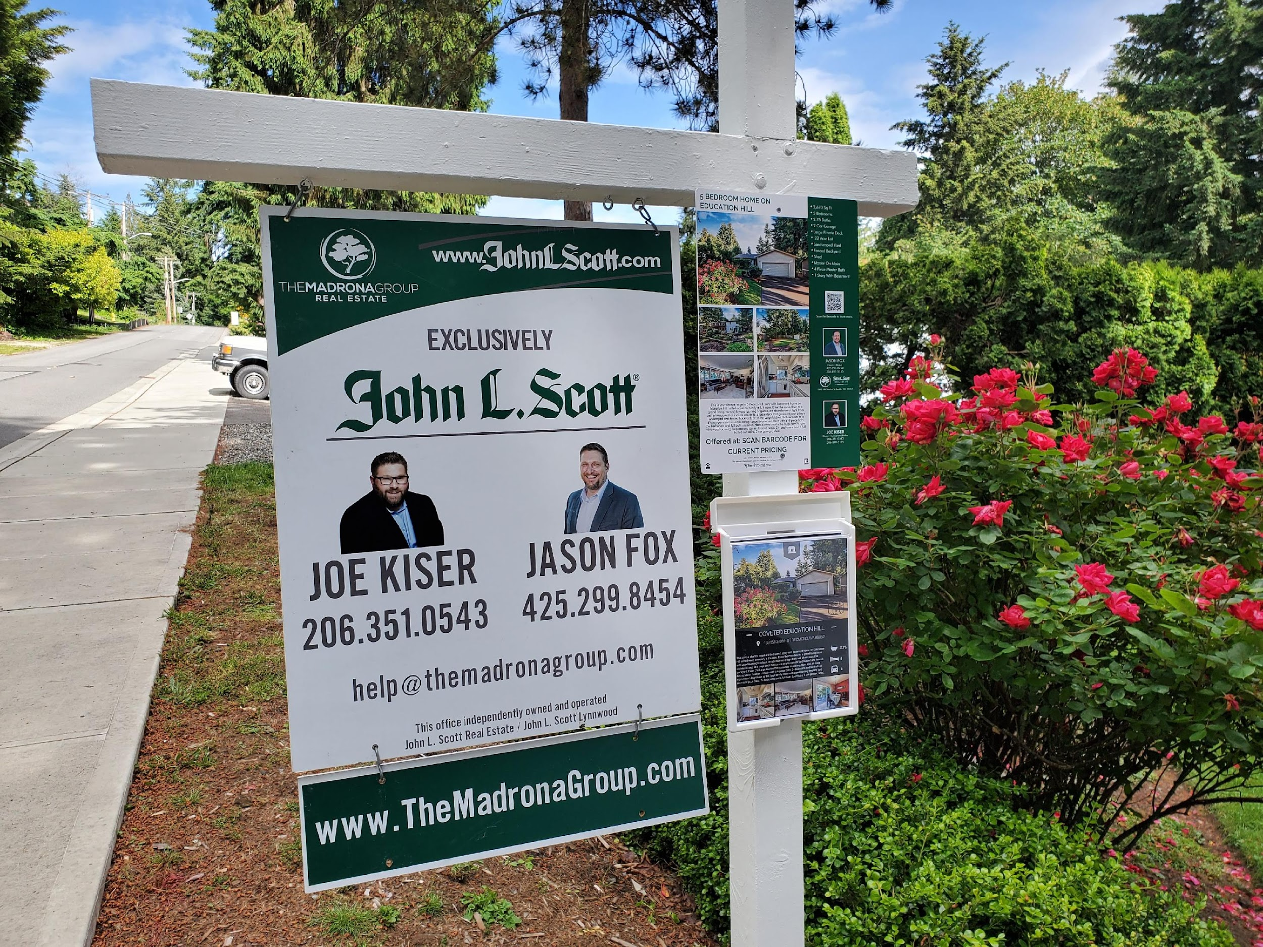
SELLER
LISTING LAUNCH
We Enhance the Psychology of the Market Place by Providing New Listings with Maximum Marketing Exposure to Increase the Motivation of the Backlog of Buyers

Slide 19













COMPLETE MARKETING STRATEGY
SIGNAGE
Yard Sign, Directions And New Listing A Board
CUSTOM FLYER
Premium Quality Flyers Inside and Out
MLS SYNDICATION
MLS, Redfin, Zillow, Trulia, Realtor.com, Juwai.com, Leading RE
LISTING WEBSITE
Custom Single Property Website
EMAIL SPHERE
Sending New Listing Alert To Over 4,000 Contacts
SOCIAL MEDIA
6,000 Monthly Visitors, 1,000+ FB, 600+, Twitter, 400+ IG, 200+ Youtube
DIGITAL ADS
Targeted Facebook and Google Ad Campaign
DIRECT MAILER
Just Listed Postcards Mailed To Neighborhood
POST OPEN HOUSE
We Market The Open House To Craigslist, Redfin, Zillow, Facebook
SHOWING TIME
Software to keep track of showings and get instant feedback
PERMAFLYER
Plastic Flyer with QR Code for easy access to listing 24/7
OPEN HOUSE
To Give Access To Neighbors and Buyers without agents
How we Maximize Your Homes Exposure to the Backlog of Buyers

Slide 20


GLOBAL EXPOSURE FOR YOUR HOME
We Are Teamed Up with Leading Real Estate Companies and Juwai.com

Slide 21


WE WILL STAY IN DIRECT COMMUNICATION
Peoples #1 Complaint With Agents is a Lack of Communication

Slide 22
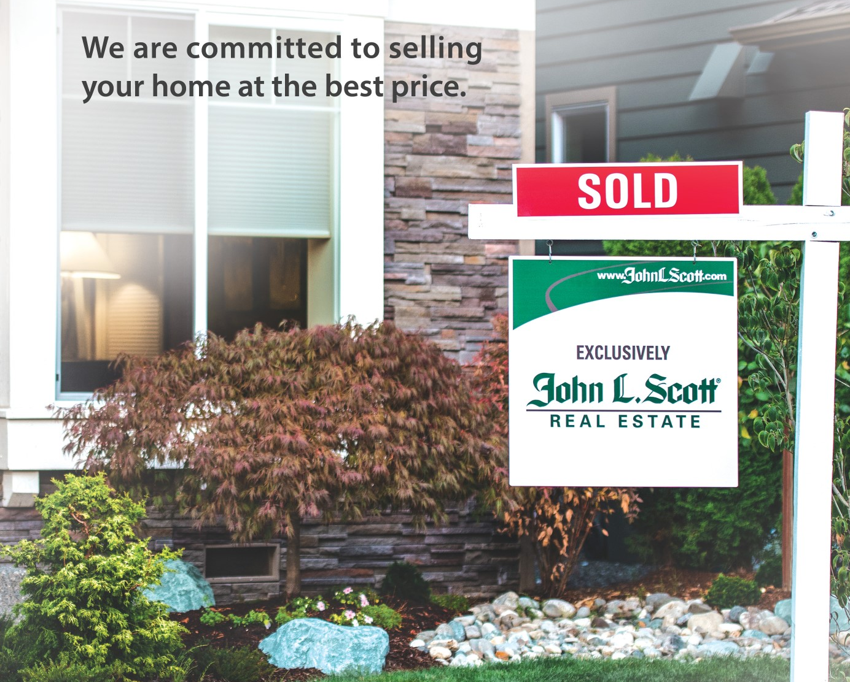
PRICING
We Will Expertly Price Your Home with Active Comparables Because…
We Want Your Home To Have a Sold Sign, We Don’t Want Other People to Use Your Listing to Sell Their Home

